Slide 1
Nottingham Core Functional Housing Market Area Boundary Study 2018
Trevor Baker
Opinion Research Services
Notes:
1

Slide 2
Housing Market Areas
The ‘first relevant building block in the evidence for identifying objectively assessed needs’
BANES Inspector

Slide 3
Project Aims
Commissioned Partners
(ORS) was commissioned by the Nottingham Core HMA, comprising Broxtowe, Gedling, Erewash, Nottingham City and Rushcliffe
Study Aims
To confirm the boundary of the Nottingham Core HMA and Functional Economic Market Area (FEMA) based on Council boundaries.
As background, in 2005 a study of HMA boundaries was commissioned by the East Midlands Regional Assembly Housing Board This study identified the HMAs covering all of the local authorities of the old East Midlands Region based upon migration and travel to work patterns from the 2001 UK Census of Population.

Slide 4
East Midlands Regional Assembly 2005

Slide 5
Definitions
Functional Housing Market Area
The definition of a functional housing market area is well-established as being “...the geographical area in which a substantial majority of the employed population both live and work and where those moving house without changing employment choose to stay”
Functional Economic Market Area
There is no standard approach to defining a functional economic market area, however, it is possible to define them taking account of factors including:
extent of any Local Enterprise Partnership within the area;
travel to work areas;
housing market area;
flow of goods, services and information within the local economy;
service market for consumers;
administrative area;
Catchment areas of facilities providing cultural and social well-being;
transport network.”
.

Slide 6
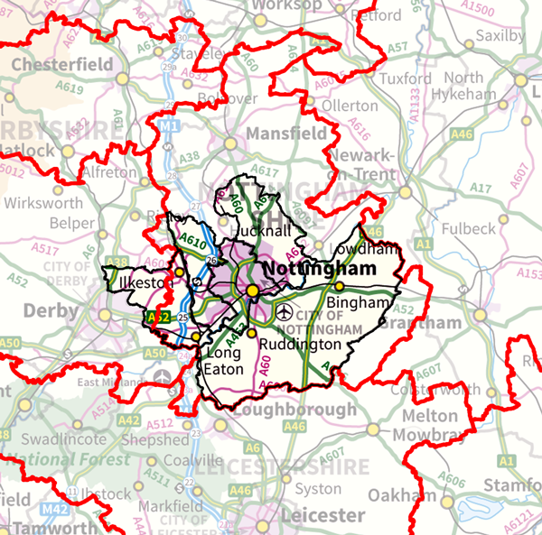
NHPAU Study 2010

Slide 7
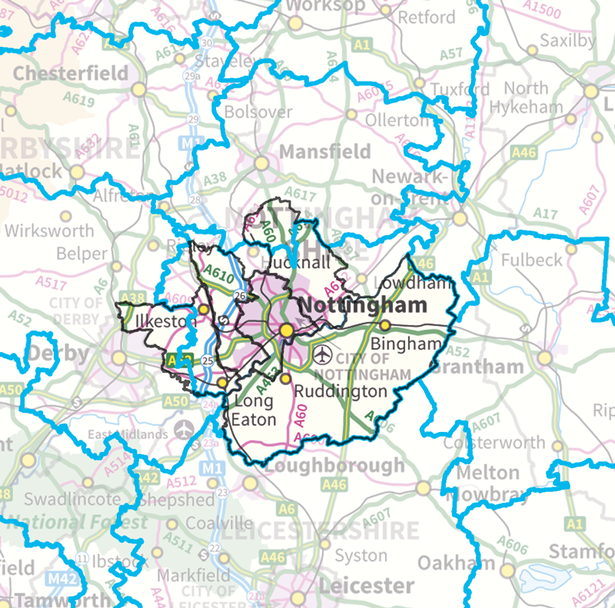
ONS Travel to Work 2015

Slide 8
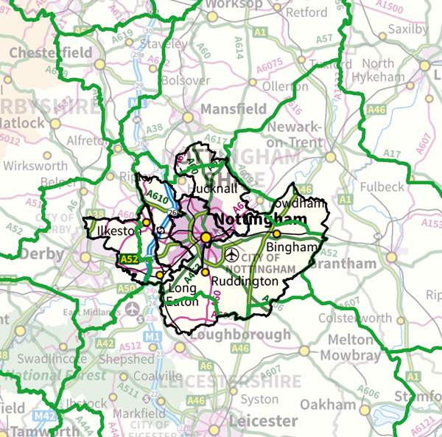
BRMA Areas

Slide 9
Commuting Self-containment Census 2011
 | Moved within LA | All Moves to LA | All moves from LA
Number of moves
Broxtowe | 4,409 | 9,869 | 10,649
Erewash | 5,592 | 9,764 | 9,822
Gedling | 4,400 | 9,189 | 9,388
Nottingham | 33,394 | 57,237 | 51,790
Rushcliffe | 4,837 | 11,026 | 10,852
 |  | % of total moves to the LA that originate from within the HMA | % of total moves from the LA to a destination within the HMA
Proportion of moves
Broxtowe |  | 73.2% | 69.0%
Erewash |  | 72.7% | 69.4%
Gedling |  | 77.3% | 72.3%
Nottingham |  | 67.5% | 76.9%
Rushcliffe |  | 69.6% | 63.6%

Slide 10
Migration Self-containment Census 2011
 | Reside and work in area | Reside in area | Work in area
Number of workers
Broxtowe | 20,004 | 53,367 | 39,012
Erewash | 26,576 | 55,112 | 43,203
Gedling | 21,725 | 55,929 | 37,164
Nottingham | 85,202 | 123,743 | 174,936
Rushcliffe | 25,324 | 55,665 | 46,256
 |  | Residents who work in area | Workers who reside in area
Proportion of workers
Broxtowe |  | 37.5% | 51.3%
Erewash |  | 48.2% | 61.5%
Gedling |  | 38.8% | 58.5%
Nottingham |  | 68.9% | 48.7%
Rushcliffe |  | 45.5% | 54.7%

Slide 11
Self Containment for Nottingham Core
 | Reside and work in area | Reside in area | Work in area
Combined area | 275,554 | 343,816 | 340,571
 |  | 80.1% | 80.9%
 | Moved within area | All Moves to area | All moves from area
Combined area | 67,711 | 97,085 | 92,501
 |  | 69.7% | 73.2%

Slide 12
Conclusions
HMA and FEMA
There is no single correct definition of an HMA and FEMA, but the CURDS HMA analysis, ONS Travel to Work Areas and BRMAs all indicate that the Nottingham Core HMA authorities of Broxtowe, Gedling, Erewash, Nottingham City and Rushcliffe are all located within the same HMA and FEMA.
The migration and commuting data also supports a Nottingham Outer HMA and FEMA containing Ashfield, Mansfield and Newark and Sherwood.
The town of Hucknall is in the administrative area of Ashfield, but within the functional HMA and FEMA for Nottingham Core HMA, while areas of Broxtowe, Erewash, Gedling, and Rushcliffe lie inside of other functional HMAs and FEMAs.
However, from an administrative and practical point of view it is necessary for HMAs and FEMAs to follow local authority boundaries and the five authorities in the Nottingham Core HMA and FEMA remain the most appropriate grouping.

Slide 13
THANK YOU FOR LISTENING
Any Comments or Questions?

