Slide 1
Wetland Landscapes for All
Across the Trent, Leen and Erewash Valleys
Janice Bradley
Head of Conservation
Nottinghamshire Wildlife Trust

Slide 2
Activities and Outcomes
3 river valleys
13 project sites
8 partner
organisations
Leen Valley
Health and
wellbeing
benefits
Employment
and skills
benefits
Erewash Valley
Trent Valley
Green
infrastructure
improvements
Biodiversity
enhancements
Notes:
Overview of the WLFA programme
How it came about

Slide 3
Partners and projects
Hall Om Wong Open Space
Netherfield Lagoons
Portland Park
Skylarks Nature Reserve
The Hook
Titchfield Park
Toton Fields Nature Reserve
Attenborough Nature Reserve
Brinsley Headstocks
Colwick Country Park
Erewash Canal
Erewash Meadows
Farley’s Brook
Notes:
Who was involved and where did the delivery take place

Slide 4
Value for money
£195,000
from Growth Point funding awarded by the Greater Nottingham Planning Partnership
+
What did we achieve…
£75,000
match from partners
=
£270,000
Notes:
How were the projects funded
But more importantly, what did we do with the Growth Point funding?

Slide 5
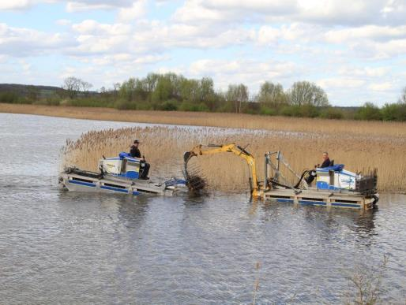
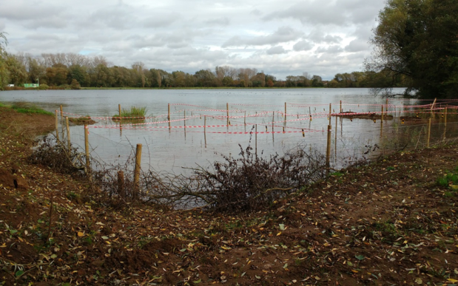
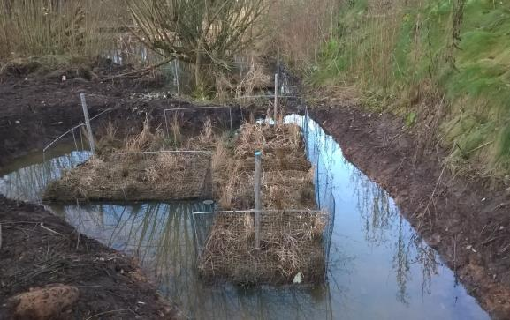
Biodiversity – revitalising over 2.5ha of reedbeds
Notes:
Netherfield, Colwick and Farley’s Brook
Colwick used spare reeds from Netherfield
Netherfield trialled amphibious machine

Slide 6
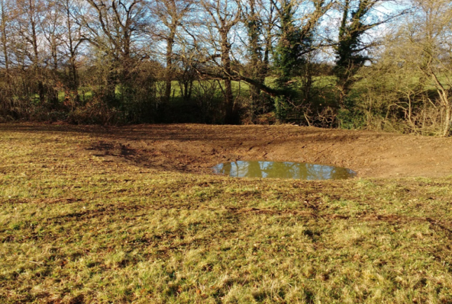
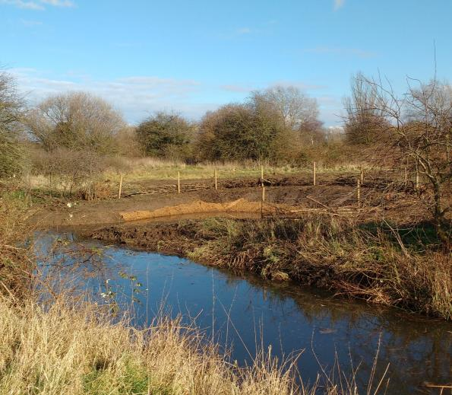
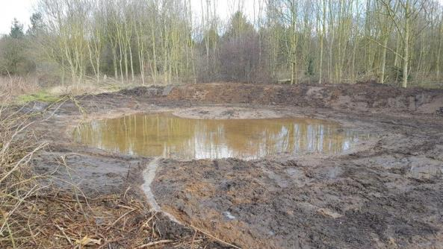
Biodiversity – new ponds and scrapes at three project sites
Notes:
The Hook
Brinsley Headstocks
Toton Fields

Slide 7
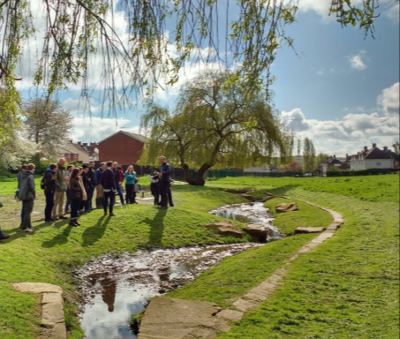
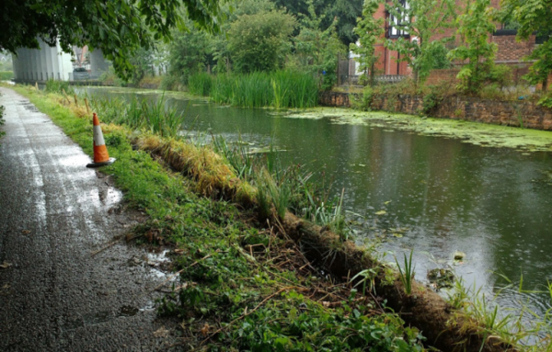
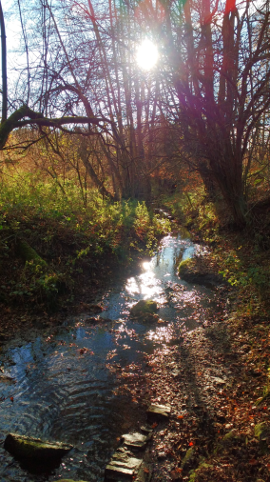
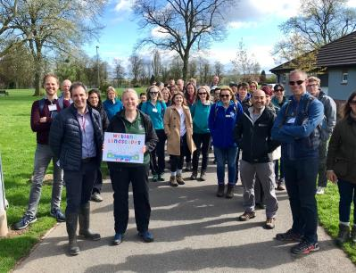
Biodiversity – rivers, canals and streams
And a visit from the River Restoration
Centre’s annual conference delegates
Notes:
Titchfield Park, Erewash Canal and Portland Park
Restoring, renaturalising rivers and canals
Successfully hosted a visit to Titchfield Park by the RRC – international delegates!

Slide 8
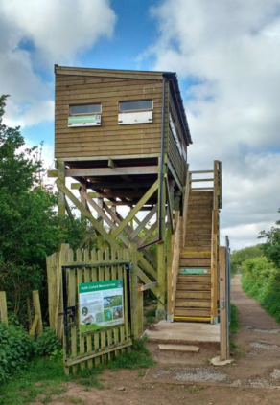
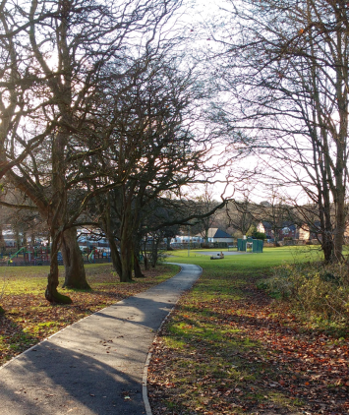
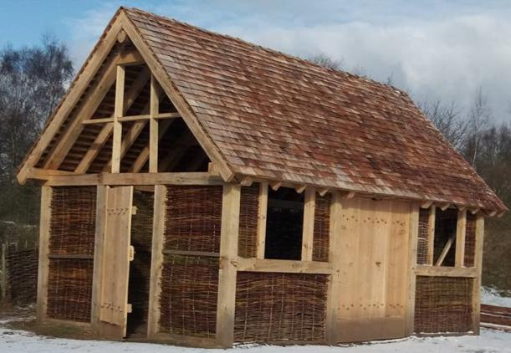
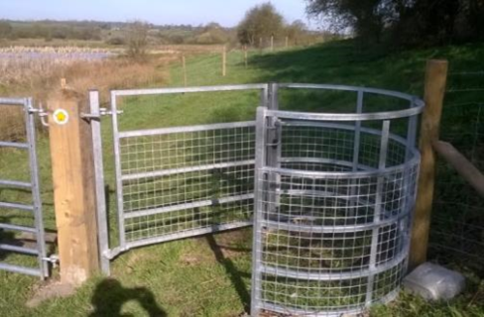
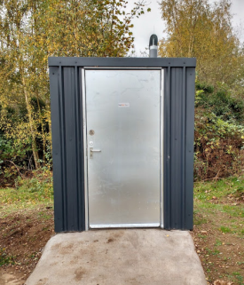
Access – new paths, steps, fences, gates, a classroom and a loo!
Notes:
Helping people to access their local wetland sites

Slide 9
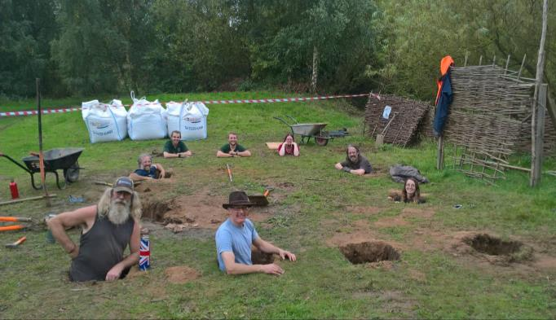
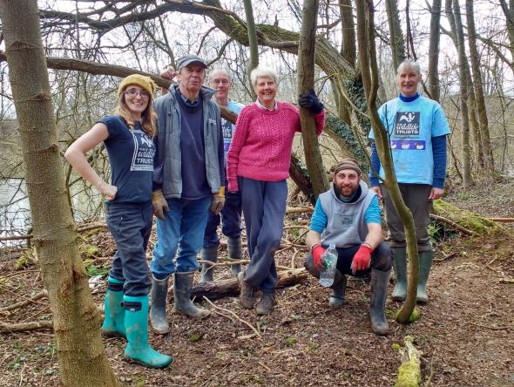
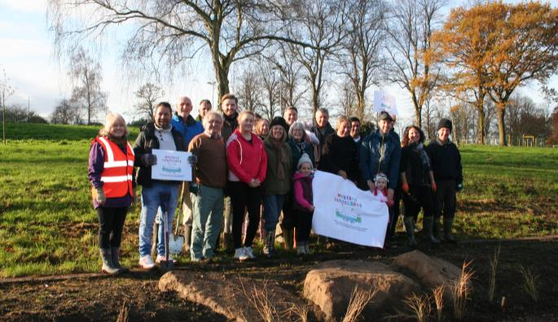
Volunteering – over 300 hours!
Notes:
Training, development, new skills
Digging holes, planting

Slide 10
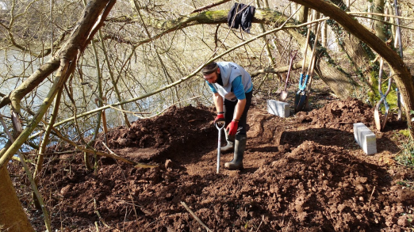
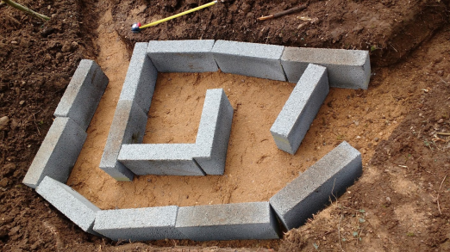
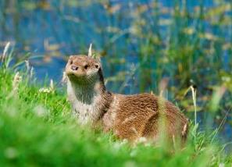
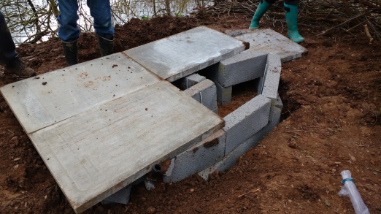
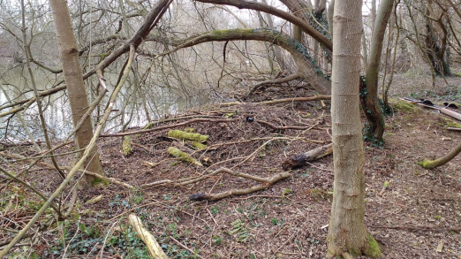
A bonus for otters…..
Notes:
Bonus project – good financial management
Added value
Artificial otter holt
Volunteers installed

Slide 11
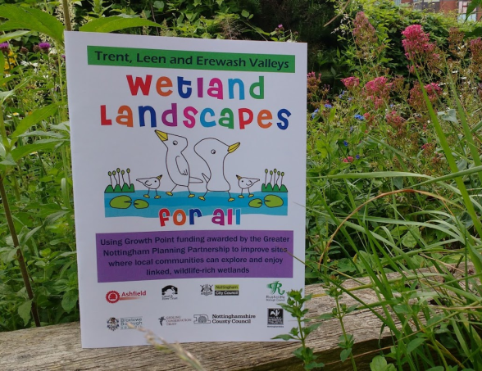
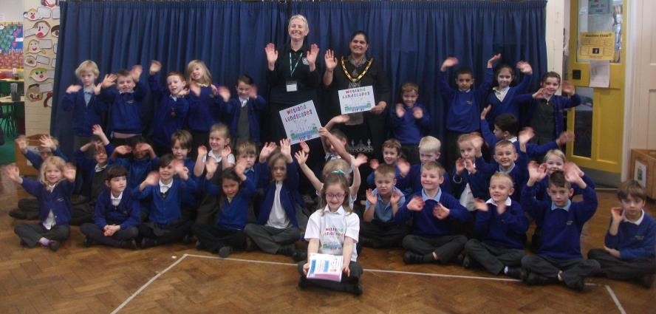
Branding
Notes:
Logo competition to engage local schools
Winning pupil from William Lilley Infant and Junior School in Stapleford
Mayor of Broxtowe presented prize
Leaflet (pdf and hard copy) now available to showcase WLFA part 1
WLFA Part 2…….?

Slide 12
Thanks for listening
Any questions?
jbradley@nottswt.co.uk
csambridge@nottswt.co.uk

