Slide 1
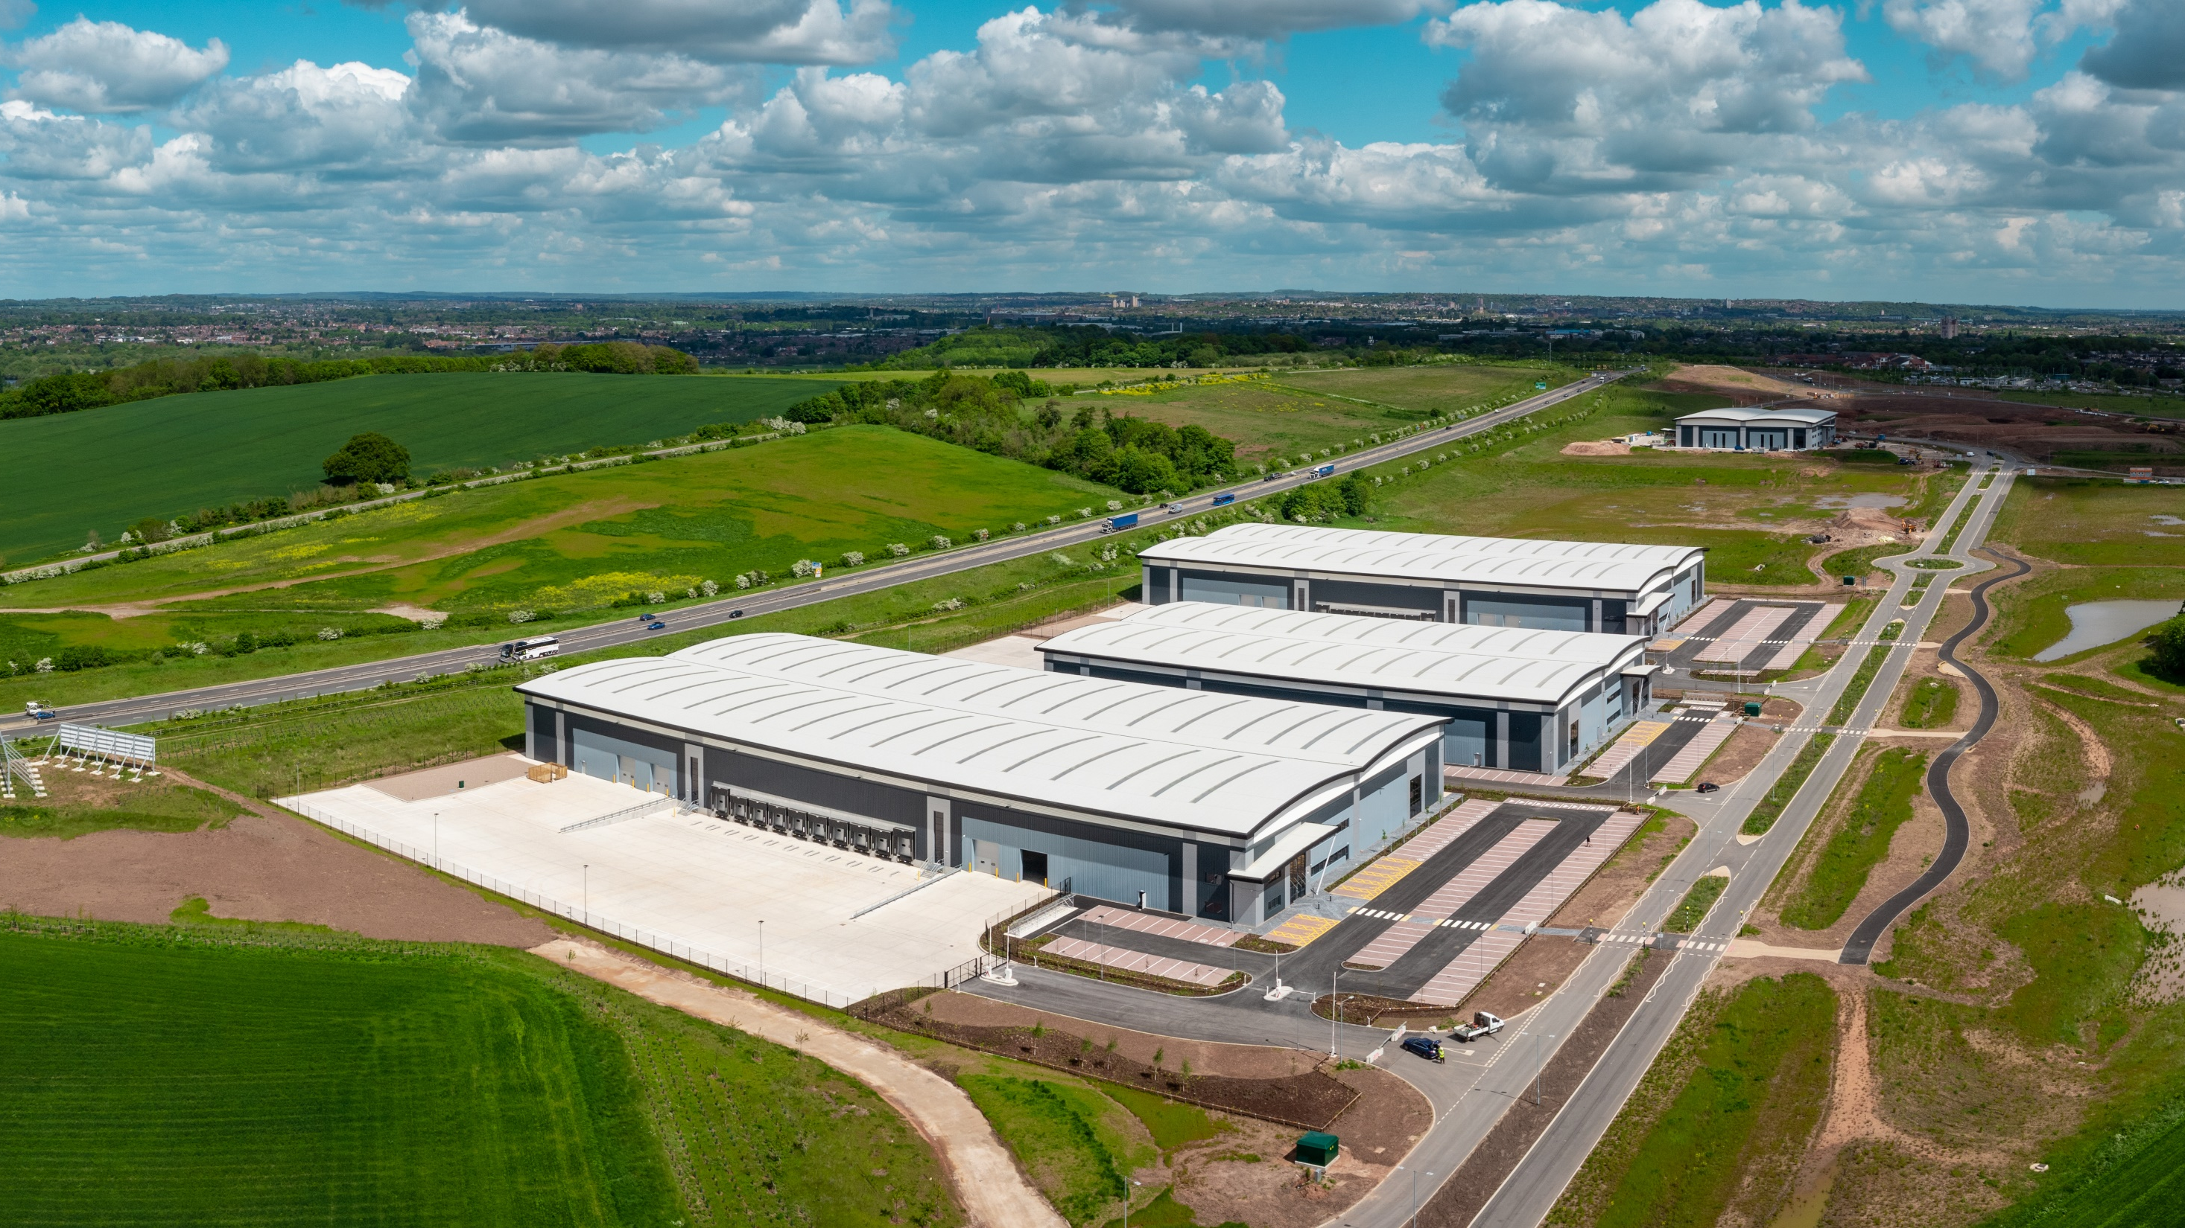
Greater Nottingham Strategic Plan: Strategic Distribution and Logistics Preferred Approach
John King (Conurbation Planning Policy Manager)
Notes:
Earlier in March this year officers updated JPAB on the Logistics work, specifically the call for sites and next steps.
This work has progressed and today the Partnership commenced consultation on the GNSP Strategic Distribution and Logistics Preferred Approach.
This issue was not addressed within the previous Preferred Approach in Jan/Feb as site assessments had not been completed at the time.

Slide 2
Nottingham Core and Outer Employment and Logistics Studies
Lichfields Employment Land Study (May 2021)
recommended further consideration of logistics needs within the Nottingham Core and Outer Area.
Iceni Logistics Study (August 2022)
warehousing and logistics facilities within the Study Area.
requirement for 1,486,000 sq. m or 425 hectares of logistics space
residual need of between 137 – 155 ha.
sites should be at least 25 ha. 50 ha sites or larger are preferred.
Concluded that 2 or more sites may be required (depending on their size).
Notes:
Background

Slide 3
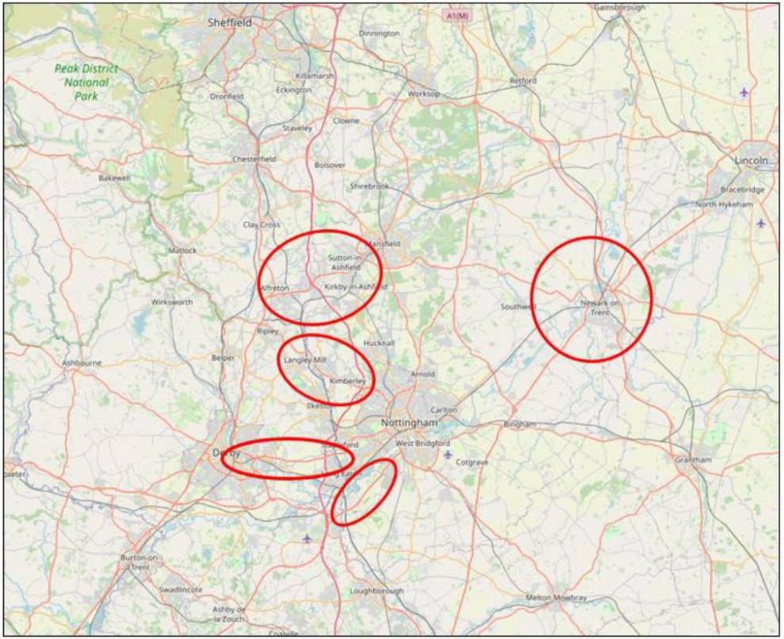
Logistics Study identified the following ‘Areas of Opportunity’:
M1 Junctions 28 and 27
M1 Junction 26
M1 Junction 25
Adjacent to A453
Newark (along A1 and A46)

Slide 4
“Call For Sites”
Greater Nottingham Councils only (Ashfield, Broxtowe, Erewash, Gedling, Nottingham City and Rushcliffe)
August / September 2022
26 sites submitted.
5 in Ashfield
9 in Broxtowe
1 in Erewash
2 in Gedling
9 in Rushcliffe
None within Nottingham City
GNSP site submissions have also been assessed

Slide 5
Distribution and Logistics Preferred Approach
Six week consultation commences today (26 September 2023) and ends on the 7 November 2023
Using the Consultation Portal https://gnplan.inconsult.uk/gnsplogistics/consultationHome
Opportunity to consult stakeholders prior to submission (whilst other commissioned work is completed).

Slide 6
Distribution and Logistics Preferred Approach
Identifies two preferred sites:
Former Bennerley Coal Disposal Point
Ratcliffe on Soar Power Station
Informed by a Background Paper (which includes Ashfield & Erewash)
Identifies a residual need of 131 and 147 hectares across Nottingham Core and Outer Area (taking into account existing commitments and pipeline sites)
Identifies three preferred sites (one in Erewash (Stanton))
Not all the Core and Outer Area’s residual need will be met through the Strategic Plan (circa 70 hectares)
Supported by a Sustainability Appraisal

Slide 7
Site Selection Process
Background Paper
Three step site selection process:
Establishing a pool of possible sites (call for sites and previous consultation submissions)
Identifying reasonable alternatives (based on size, location and proximity to the highway network)
Determining the preferred sites according to planning status, constraints and benefits.
Sustainability Appraisal
Assessed all reasonable alternatives against the SA objectives

Slide 8
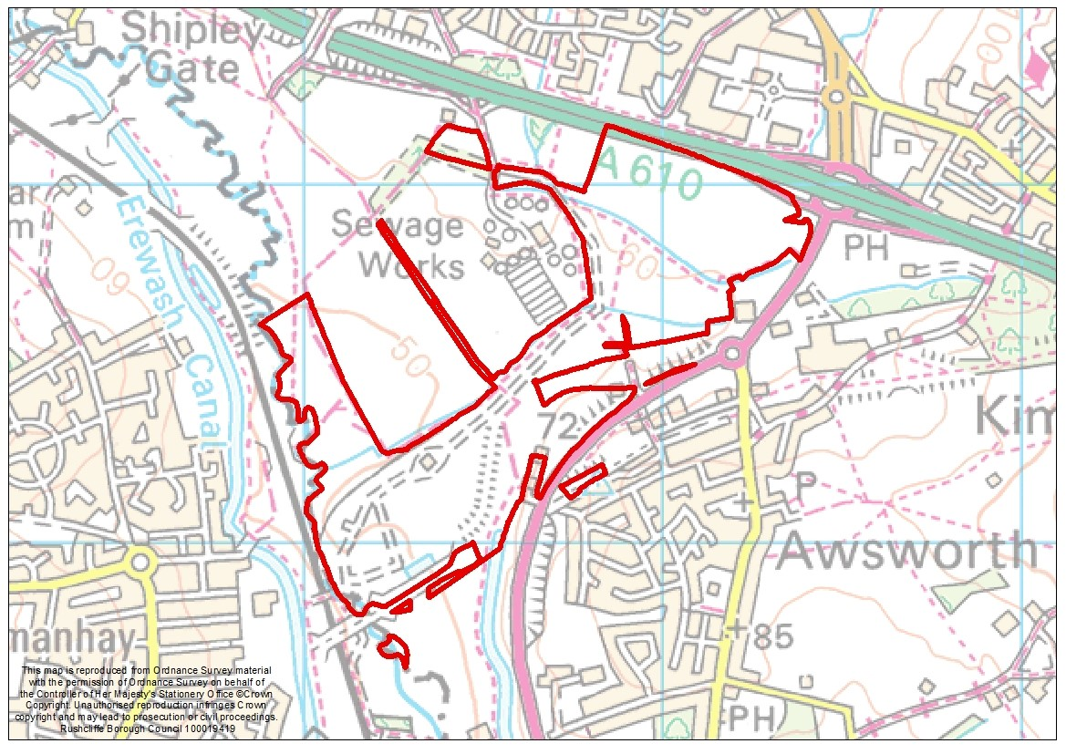
Bennerley Coal Disposal Point
Adjacent to A610 and close to junction 26 of the M1
Deliver 74,000+ sqm of B8 development
Adjacent to the rail network
Close to sources of labour and areas of lower employment
Contains substantial areas of brownfield land
Setting of Bennerley viaduct
Impact on Erewash Valley blue and green infrastructure
Flood risk avoidance/mitigation
Green Belt – exceptional circumstances

Slide 9
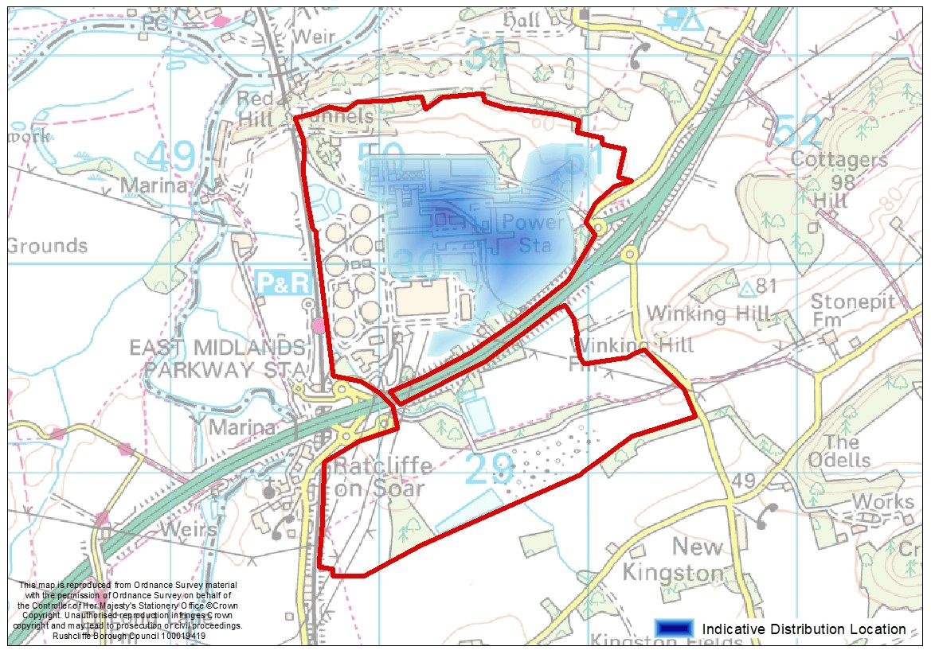
Ratcliffe on Soar Power Station
Adjacent to A453 with access onto the nearby M1 via Junction 24
Brownfield (north or A453 where B8 development is proposed)
Site has existing rail access
Deliver 180,000 sqm of B8 development (approved within an adopted LDO)
Allocation for B8 uses within the Greater Nottingham Strategic Plan will remove the site from the Green Belt.

Slide 10
Next steps
Complete Preferred Approach consultation and review comments and further evidence submitted.
Subject to Council approvals allocate preferred sites within the Publication Draft of the Greater Nottingham Strategic Plan.
Questions?

