Slide 1

Strategic Logistics and “Call for Sites”
John King (Conurbation Planning Policy Manager)
Graeme Foster (Principal Planning Policy Officer GBC)

Slide 2

Nottingham Core and Outer Logistic Study
Lichfields Employment Land Study (May 2021)
  The study included a specific recommendation to give further consideration to assess the need to make provision or not for major logistics facilities within the Nottingham Core and Outer Housing Market and wider area.
Iceni Study (August 2022)
  Iceni commissioned to understand the future demand for strategic warehousing and logistics facilities within the Study Area.

Slide 3
Nottingham Core and Outer Logistic Study
Commissioned by Ashfield, Broxtowe, Erewash, Gedling, Mansfield, Newark & Sherwood, Nottingham and Rushcliffe councils
Prepared within the context of national planning policy and guidance
Takes into account other adjoining Councils’ studies on strategic distribution demand and supply such as the Leicester and Leicestershire Study and the Bassetlaw A1 Study
The Iceni study has been undertaken from a ‘policy off’ perspective. This means that constraints most notably in terms of the Green Belt have not been considered in the ability of the area to accommodate future logistic requirements.

Slide 4
Nottingham Core and Outer Logistic Study
The requirement for planning policy purposes should be 1,486,000 sq. m or 425 hectares of logistics space
There is 315,000 sq. m of committed supply (units over 9,000 sq. m with planning permission or allocations in adopted local plans)
Potential “pipeline” sites would reduce the need to 601,000 sq. m or 172 hectares subject to the allocations being confirmed.
Assuming some demand met on redevelopment of existing warehousing sites then there is a residual need of between 137 – 155 ha.
Recommended sites should be at least 25 ha. 50 ha sites or larger are preferred.
Concluded that 2 or more sites may be required (depending on their size).

Slide 5
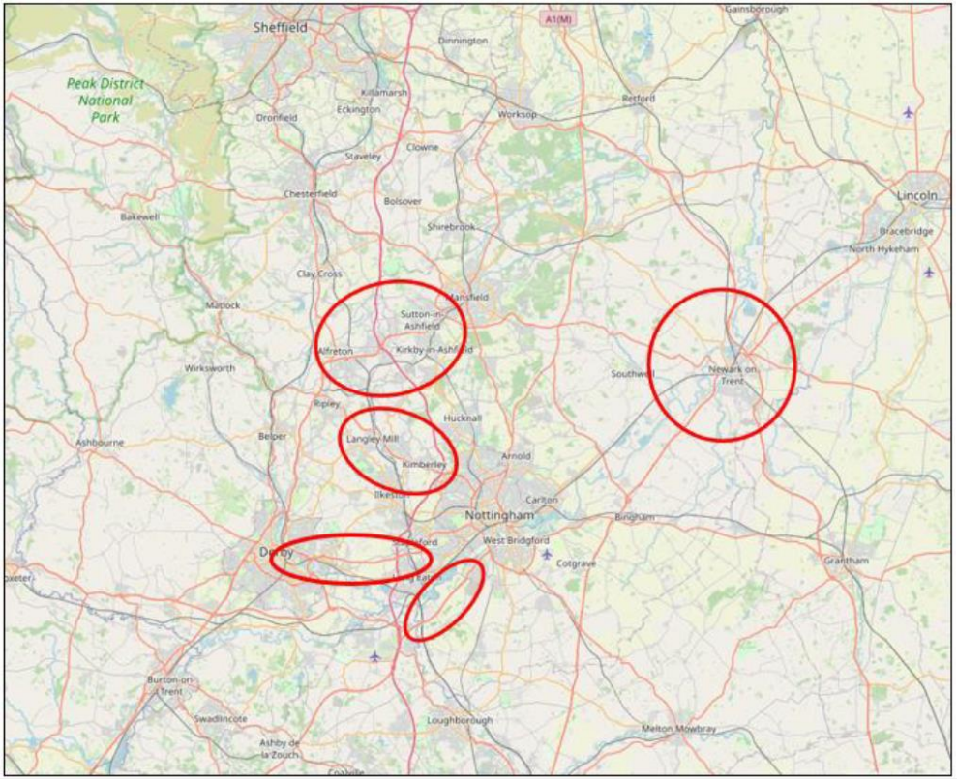
Identified the following ‘Areas of Opportunity’:
  M1 Junctions 28 and 27 (Sutton in Ashfield, Alfreton and Kirby in Ashfield)
  M1 Junction 26 (Langley Mill, Eastwood and Kimberley)
  M1 Junction 25
  Adjacent to A453
  Surrounding Newark (along A1 and A46)

Slide 6

Approach: Site Search
Step 1: establish an initial “pool” of potential sites inviting developers to submit sites or sites already promoted through consultation on the Growth Options;
Step 2: undertake detailed assessment of the “reasonable alternatives”; and
Step 3: decide which sites may be suitable for allocation.

Slide 7
“Call For Sites”
Greater Nottingham Councils only (Ashfield, Broxtowe, Erewash, Gedling, Nottingham City and Rushcliffe)
August / September 2022
26 sites submitted.
  5 in Ashfield
  9 in Broxtowe
  1 in Erewash
  2 in Gedling
  9 in Rushcliffe
None within Nottingham City.

Slide 8
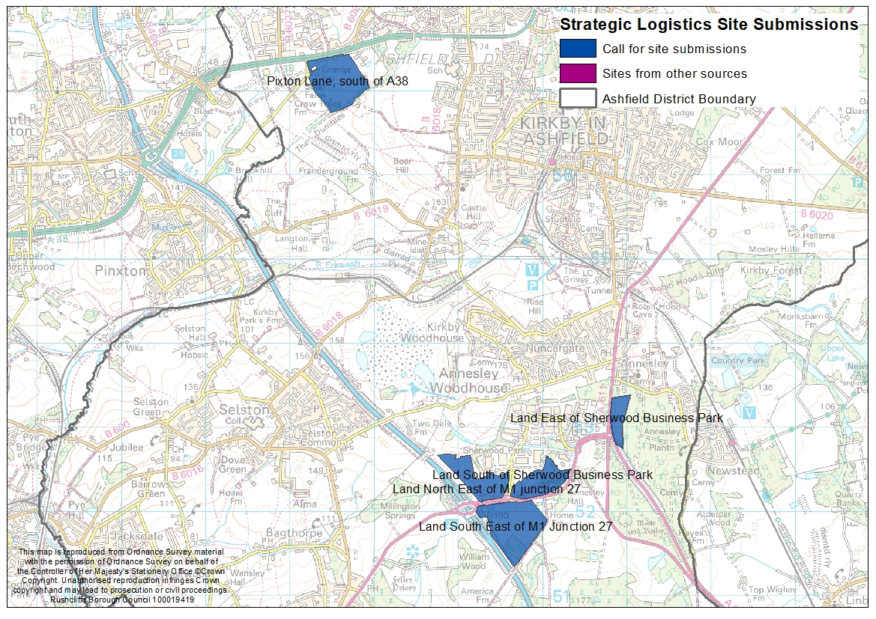
Ashfield

Slide 9
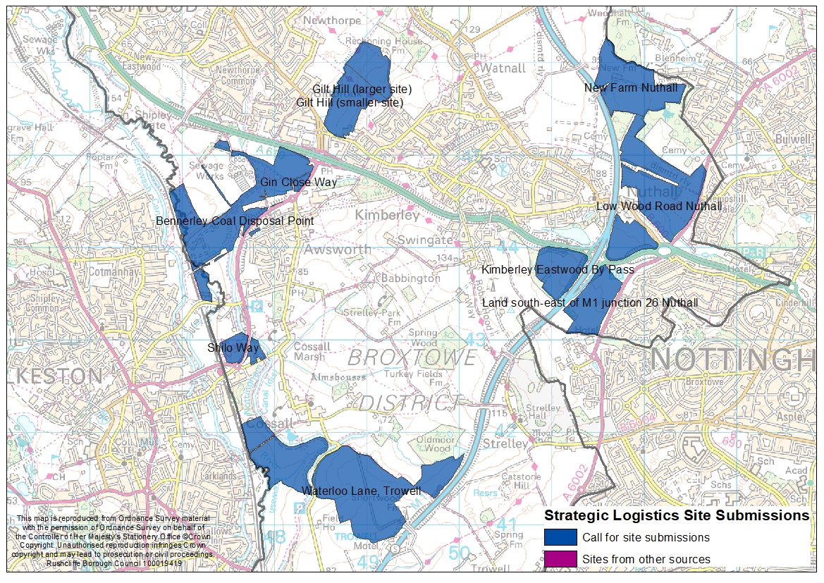
Broxtowe

Slide 10
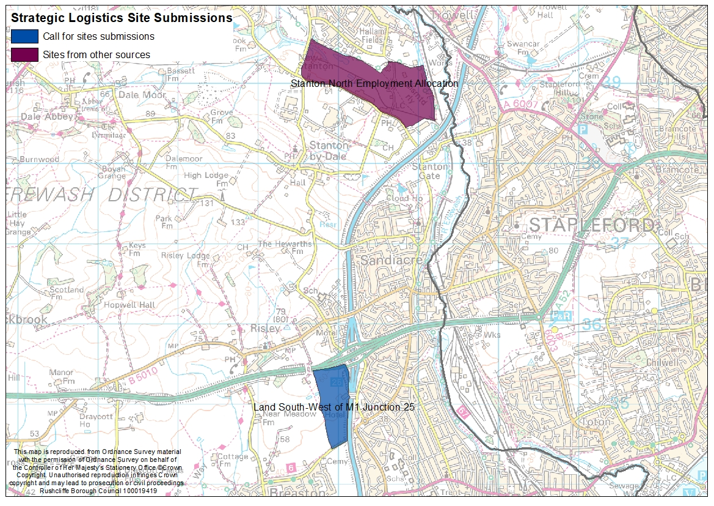
Erewash

Slide 11
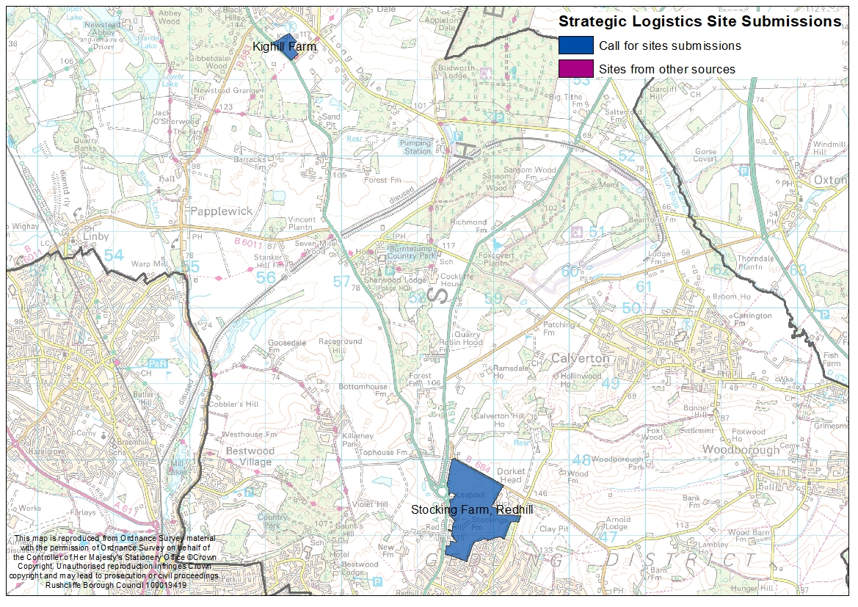
Gedling

Slide 12
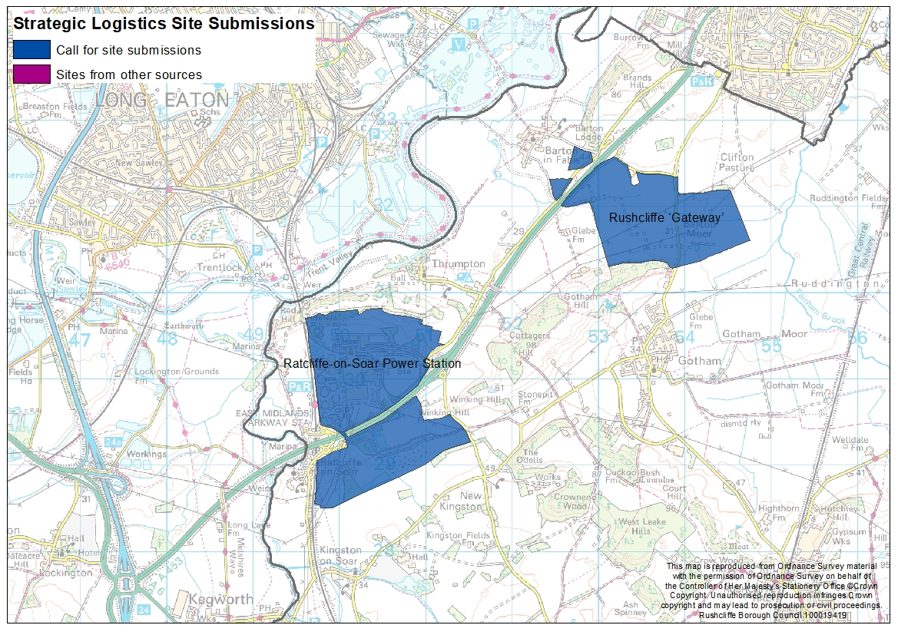
Rushcliffe A453

Slide 13
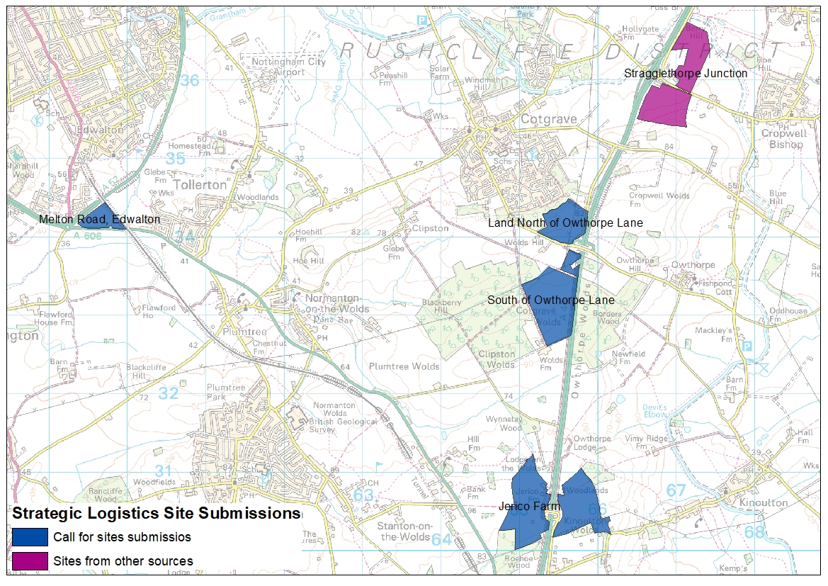
Rushcliffe A46

Slide 14
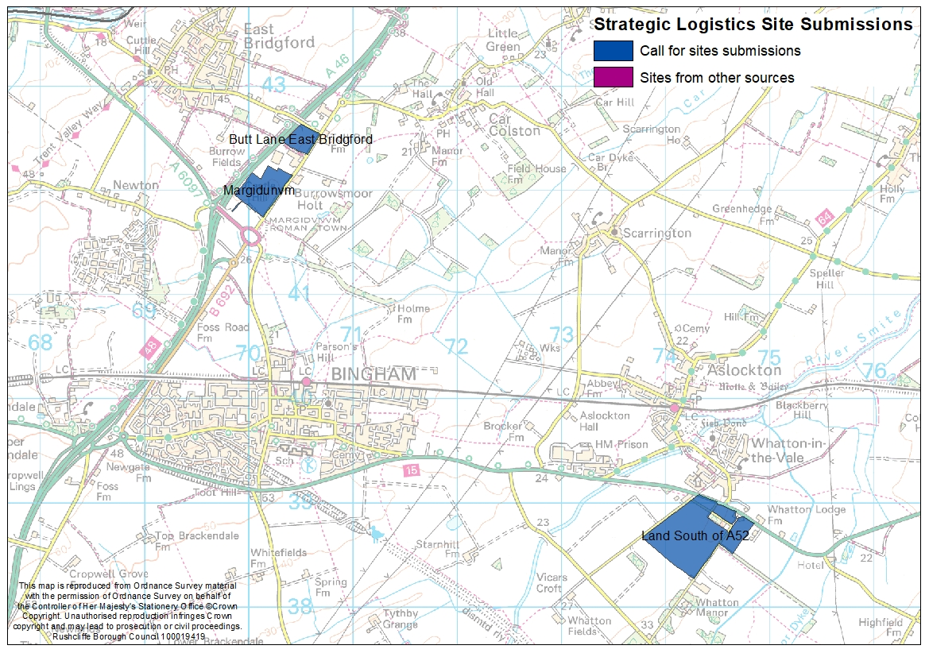
Rushcliffe A46 and A52

Slide 15
Assessment Criteria: Operational
Within or close to an Area of Opportunity (M1, A453, A46/A1 (Newark));
Good connections with the strategic highway network – close to a junction with the motorway network or long-distance dual carriageway;
Access to the rail network;
Sufficiently large and flexible in its configuration;
Served from an electricity supply grid with sufficient capacity; and
Accessible to labour, including the ability to be served by sustainable transport.

Slide 16
Assessment Criteria: Constraints
    Green Belt considerations;
    Flood risk;
    Impact on the natural and historic environment;
    Landscape and visual impacts; and
    Compatibility with surrounding land uses.
  Are there any other operational criteria or constraints we should consider?

Slide 17
Next steps
Complete site appraisals (including Sustainability Appraisal of “reasonable alternatives”).
Make recommendations to Members / Councils.
Subject to Council approvals allocate any selected sites within the Publication Draft of the Greater Nottingham Strategic Plan anticipated late 2023.

