Slide 1
Greater Nottingham and Ashfield
Housing Needs Assessment
Report Presentation
May 2020

Slide 2
Context to the Study
The GNPP has commissioned Iceni Projects to prepare a Housing Needs Assessment.
The National Planning Policy Framework (“NPPF”, February 2019) sets out that Local Plans should positively seek opportunities to meet the development needs of their area, and be sufficiently flexible to adapt to rapid change and strategic policies should, as a minimum, provide for objectively assessed needs for housing and other uses.
As part of this, the NPPF is also clear that the size, type and tenure of housing needed for different groups in the community should be assessed and reflected in planning policies.
The Housing Needs Assessment has therefore been prepared for the Greater Nottingham and Ashfield area in order to support the preparation of Local Plans looking ahead to 2037 in Ashfield and to 2038 in all other authority areas; and to provide evidence to support housing market interventions and prospective future funding bids.

Slide 3
The Starting Point – Overall Housing Need
The assessment has used the local housing need derived from the standard method to inform the analysis throughout.
The standard method of calculating local housing need is prescribed by Government. Local housing need is calculated over the 10 year period from 2020 to 2030 on an annual basis.
Across the study area, there is a need for 3,452 homes per annum with the local housing need for each local authority set out in the Table.

Slide 4
Submarkets – Identification
The report has sought to identify submarkets across the study area. As settlements across the study area differ greatly in terms of house prices and the profile of housing, it is helpful to identify submarkets to inform analysis and outputs on affordable housing needs and housing mix.
Submarkets are helpful in establishing the appropriate level of affordable housing and the appropriate housing mix to be delivered in particular areas where the need is likely to differ greatly to the District-wide recommendations.
The submarkets in the report have been built up using geographical boundaries at a ward level, using the latest 2019 ward boundaries.
The analysis has principally been based on viability – looking at the profile of housing sales across the study area as well as house price differentials/similarities.
It is important to note that within submarkets, there will be some variances.

Slide 5
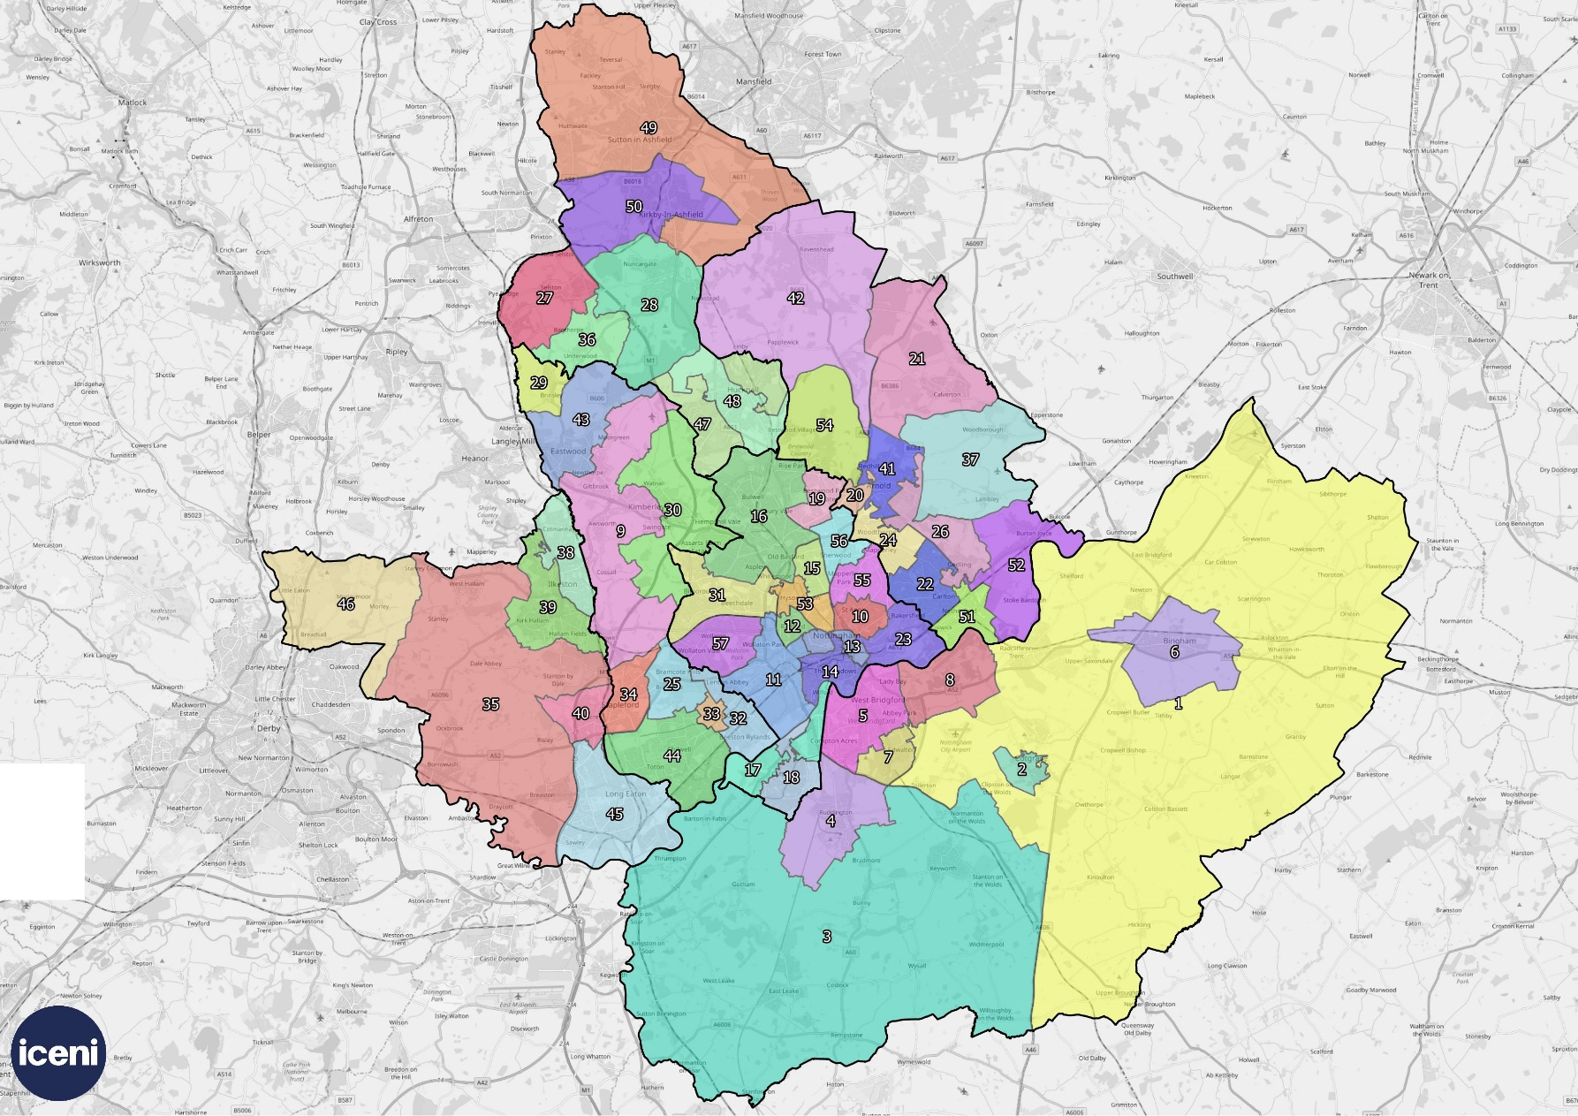
Submarkets - Outputs
The analysis in the report has resulted in the identification of 59 submarkets across the study area. This is the same number as the 2007 SHMA; although this study includes the Ashfield District in its entirety.
The submarkets in this study should be viewed at a point in time and will invariably be subject to change over time.

Slide 6
Affordable Housing - The Approach
Future Housing Need
Estimate of Newly-Forming Households in Need & Existing Households falling into Need over plan period
Current Housing Need (Gross)
Current Households in Housing Need based on Housing Register/secondary data sources
The approach to considering affordable housing is based on the standard method (further detail in slide notes).
The method draws on the traditional definition of affordable housing.
The analysis is based on the entry-level rent (i.e. lower quartile) and how much of their income people tend to spend on renting in each local authority.
Our assessment looks at affordable rented housing (social/affordable) and affordable home ownership. The latter has been introduced by the new NPPF.
Net Housing Need Arising
Total Net Current Need
Affordable Housing Supply
Estimate of Supply of Affordable Housing from Relets of Existing Properties over plan period
Affordable Housing Supply
Supply of Affordable Housing from Vacant Stock & Development Pipeline
Total Net Current Need
Over the Plan Period
Notes:
The method for studying the need for affordable housing has been enshrined in Government practice guidance for many years, with an established approach to look at the number of households who are unable to afford market housing (to either rent or buy). The methodology considers the following:
- Current affordable housing need: an estimate of the number of households who have a need now, at the point of the assessment, based on a range of data modelled from local information – this figure is then annualised so as to meet the current need over a period of time;
- Projected newly forming households in need: using demographic projections to establish gross household formation, and then applying an affordability test to estimate numbers of such households unable to afford market housing;
- Existing households falling into need: based on studying past trends in the types of households who have accessed social/affordable rented housing; and
- Supply of affordable housing: an estimate of the likely number of lettings that will become available from the existing social/affordable housing stock.
The first three bullet points above are added together to identify a gross need, from which the supply of relets of existing properties is subtracted to identify a net annual need for additional affordable housing. For the purposes of this assessment, this analysis is used to identify the overall net need for social/affordable rented housing.
This approach has traditionally been used to consider the needs of households who have not been able to afford market housing (either to buy or to rent). As the income necessary to afford to rent homes without financial support is typically lower than that needed to buy, the ability of households to afford private rents has influenced whether or not they are in need of affordable housing.

Slide 7
Affordable Rented Housing (p.a.)
There is a relatively high level of affordable housing need per annum in comparison to overall housing need for all authority areas. This is particularly the case in Nottingham.
In comparison, the affordable rented figure alone is equal to 77% of the study area’s local housing need.
However, it is important to highlight that this figure is not a target and the link between overall need and affordable need is complex.
For instance, those not in accommodation (mainly newly forming households) are already captured in the demographic projections (i.e. included in housing numbers). It is therefore not a straightforward comparison exercise.
The affordable housing target will also have to be subject to viability testing.
Notes:
For information, the need is significantly higher in this assessment than the last assessment published in 2009. This is principally due to the supply of relets being much lower in all authority areas. For example, Nottingham City had 3,410 relets per annum as at 2009 whereas as now, the supply of relets is just 883 per annum. The reason for this is due to Right to Buy.

Slide 8
Affordable Home Ownership
The NPPF has introduced updated definition of affordable housing which includes households who might be able to rent without financial support but who aspire to own a home, and require support to do so.
This expanded definition has been introduced by national Government to support increased access to home ownership, given evidence of declining home ownership and growth in private renting over the last 10-15 years.
There is no specific guidance on how the needs of these households should be assessed. As a result, we have adopted a broadly consistent method to that set out in the PPG.
We use the traditional calculation but this is based on those able to afford to rent but not buy.
The supply is based on a range of: Max (number of homes sold at below lower quartile (i.e. entry-level) prices) and Min (number of homes sold at a price affordable to those able to afford to rent privately).

Slide 9
Affordable Home Ownership (p.a.)
Our analysis shows there is no real need for affordable home ownership products across the study area, except from in Rushcliffe Borough where house prices are notably higher.
However, authorities can choose to provide affordable home ownership products due to there being some households who would suit an affordable product. This is particularly true for particular affordable products such as Shared Ownership.
The authorities will have to weigh up the relative affordability of products (e.g. social rent vs low cost home ownership) and the viability of products.
For example, providing more social housing will meet more acute needs but it is less likely to be viable and therefore fewer affordable homes are likely to be provided overall.
Additional detail is provided in the slide notes.
Notes:
Owing partly to housing being generally affordable across the study area with the exception of Rushcliffe, the assessment has found that there is no net need for affordable home ownership products.
It should be noted that there is a requirement in the NPPF for authorities to provide a minimum of 10% of all new housing (on larger sites) for affordable home ownership, unless this would exceed the level of affordable housing required in the area, or significantly prejudice the ability to meet the identified affordable housing needs of specific groups.
Our assessment essentially finds that in Greater Nottingham and Ashfield, the clear need for additional rented housing would arguably mean that providing the affordable home ownership would ‘prejudice the ability’ to meet the needs of the ‘specific group’ requiring rented accommodation.
This is not to say that provision should not be made for affordable home ownership products, as there are clearly some households in the gap between renting and buying; however, there is a choice for each local authority in respect of prioritisation and strategy.

Slide 10
Older Persons - Need for Accommodation
The assessment has also analysed the need for older persons accommodation.
All of the individual local authorities show a notable increase in the older person population over the period from 2020 to 2038, with the increase in the population aged 65 and over varying from 29% in Broxtowe, up to 43% in Ashfield.
The Tables set out the need for specialist accommodation in Ashfield, Broxtowe and Erewash.
The greatest need is seen in Ashfield with a need for all forms of housing with support and housing with care.

Slide 11
Older Persons - Need for Accommodation
Across all authorities, the majority of need falls within Housing with Support (i.e. retirement living/sheltered housing).
It is important to highlight that the supply should be focussed on leasehold provision.
In all authorities except Ashfield, there is no need identified for rented housing with support across the study area.
Separately, there are projected increases for dementia and mobility problems in all authority areas.
The growth shown in those with disabilities provides clear evidence justifying delivering ‘accessible and adaptable’ homes as defined in Part M4(2) of Building Regulations

Slide 12
Older Persons - Residential Care Bedspaces
The analysis shows a current shortfall and notable projected future need. Overall, it is estimated that there is a need for around 7,200 additional care and nursing home bedspaces to 2038 across the study area.
The need is highest in Rushcliffe at 1,777 bedspaces and lowest in Broxtowe at 864 bedspaces.
These figures should be considered as a maximum level, as there is potential for some of this need to be met through provision of extra care housing. This will relate to needs arising for residential rather than nursing care.

Slide 13
Younger Adults – Change in Disabilities
The analysis shows first and foremost that there is a substantial volume of younger adults (aged 65 and under) across the study area with a range of disabilities.
The number of younger adults who are mobility impaired is expected to fall in Ashfield, Broxtowe, Gedling and Erewash; whilst the number is projected to increase by around 150 people in Nottingham and Rushcliffe.
National Planning Practice Guidance for Housing for Older and Disabled People refers only to specialist housing for older people; however, clearly local authorities should support specialist housing schemes for younger adults which come forward across the plan area.
Particularly supported housing schemes aimed at supporting those with autistic spectrum disorders and learning disabilities given these disabilities are expected to see an increase in all authority areas.

Slide 14
Housing Mix - The Approach
Future Housing Mix
Demographic Changes
Economic Growth
Current Housing Mix
Accessibility Improvements
Housing Affordability
The report has also set out to consider the appropriate housing mix to be sought on development schemes across the study area.
The analysis considers the mix of housing for three broad categories:
  Market Housing
  Affordable Home Ownership
  Affordable Rented Housing
By following a method that takes account of future demographic change, the way in which households occupy homes in different tenures (and by age) and consideration of the current stock profile, a series of outputs have been derived to consider the likely size requirement of housing within each of the three broad tenures.

Slide 15
The Recommended Housing mix
We have used our modelled outputs and have taken into account recent supply since the 2011 Census to arrive at a recommended housing mix.
It needs to be noted that to some degree the outputs seek to address the current stock profile. However, it may the case that moving too far away from the current mix could be unrealistic in some areas.
It will be appropriate for authorities to be flexible with policy to respond to differing submarket characteristics.

Slide 16
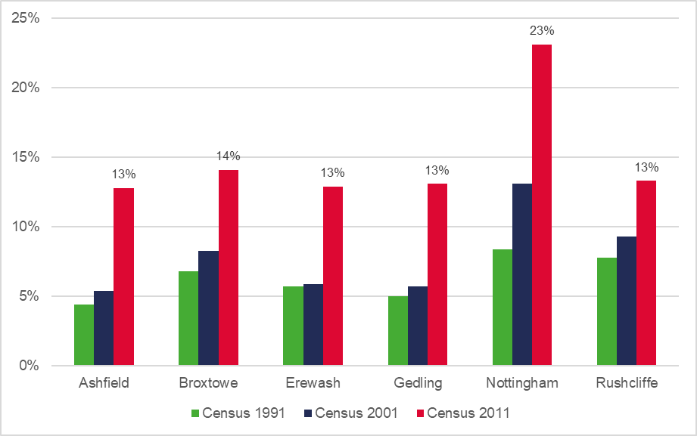
Private Renters – Growth
The analysis shows that the private rented sector has grown as a sector in each of the authority areas across the last three census points.
As a proportion of all households, the private rented sector was the second largest tenure in Broxtowe (14.1%), Gedling (13.1%) and Rushcliffe (13.3%) at the point of the 2011 Census.
Nottingham had the highest proportion of private renters at 23.1% of all households.
It should be noted however that Census data is outdated, with recent research suggesting the private rented sector has grown substantially (e.g. up to 31% of all households in Nottingham as at 2018)

Slide 17
Private Renters - Build to Rent Policy
In the context of the private rented sector’s growth, successive Governments have looked to the private rented sector to play a greater role in providing more new build housing and have sought to encourage “Build to Rent” development.
The benefits of Build to Rent have been recognised as including:
  Supporting the Local Community – help meet demand for private rented sector housing whilst increasing tenants choice. This includes offering longer tenancies and maximising occupancy levels as Build to Rent investment is an income focussed model.
  Supporting Local Growth – increases housing supply, particularly on large, multi phased sites as it can be delivered alongside for sale and affordable housing. Improves placemaking as the market absorption rate the sector is higher than build for sale.
  Financial Benefits – authorities can become directly involved in the provision of Build to Rent, given the potential to generate income or capital receipts.
Currently there is no policy in place in the authority areas. Government has been clear that where a need is identified, local planning authorities should include a specific plan policy relating to the promotion and accommodation of Build to Rent.
Iceni consider there is a need and a role for Build to Rent in responding to and supporting those various groups within the sector in all authority areas.

Slide 18
Next Steps & Final Report
The final report will incorporate submarket-level outputs on affordable housing need and will provide commentary on the criteria to be applied at a submarket level for housing mix.
Once submarket analysis is factored in, we will be circulating as a final draft for comment which will include recommendations and conclusions.
Iceni will then be able to address any final comments promptly and reissue for sign-off.

Slide 19

Contact Details

