Slide 1
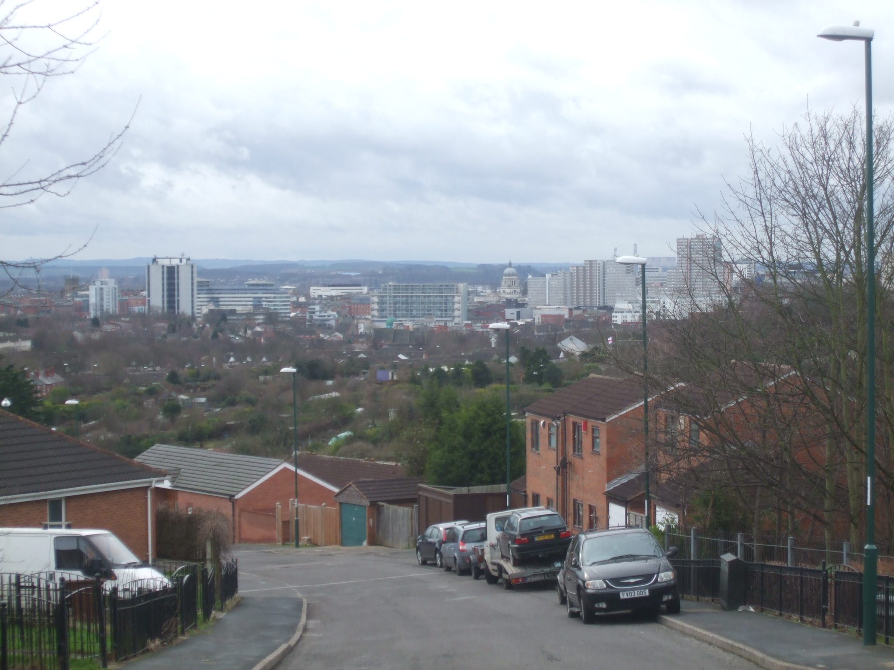
Review of Greater Nottingham SHLAAs Joint Planning Advisory Board 18 June 2019

Slide 2
Purpose of the review
Stage 1 – To review SHLAA methodologies across Greater Nottingham, to ensure robustness and consistency
Stage 2 – As a result of recommendations from Stage 1, consider what the potential uplifts in housing capacity across the Main Built-Up Area might be

Slide 3
Scope of the review
Broxtowe, Erewash, Gedling, Nottingham City and Rushcliffe
We’re a critical friend
Our work makes recommendations, but local context is crucial
Part of an ongoing process – we’re doing this at a point in time
Not necessarily any right and wrong approaches – existing assumptions being made for a good reason
But equally, acknowledged need for greater consistency and desire to maximise capacity within the Main Built-Up Area

Slide 4
The SHLAA process
Evidence-led process to support identification of land for development – NPPF paragraph 67
Further detail in Planning Practice Guidance
Not just specific sites – also other allowances, such as windfall
Notes:
NPPF para 67: “Should have a clear understanding of the land available in their area through the preparation of a strategic housing land availability assessment’. From this, planning policies should identify a sufficient supply and mix of sites, taking into account their availability, suitability and likely economic viability”.

Slide 5
What we’ve done
Reviewed all published documents
Considered against our best practice experience
Explored processes and consistency further through officer workshop
Five authorities provided current housing land supply figures
Mindful of timing vs. P2LP examinations

Slide 6
Scope of output
SHLAA methodology best practice appraisal
SHLAA methodology consistency across Greater Nottingham
Other allowances (Windfall and Non-implementation)
Methodology recommendations
Potential updated urban capacity for five authorities
Notes:
RW

Slide 7
Key findings
Processes followed are generally robust
Clear understanding of the requirements of national policy
Broadly, approaches also reflect national guidance
Approaches endorsed through examinations (Although this doesn’t always help with consistency)
Notes:
RW

Slide 8
Key findings
Opportunity to improve consistency by setting out prescribed approaches in public documents
Achievability/viability issues not always covered thoroughly
Density varies from 20 to 35dph, which may be relatively low
Detailed approaches for numbers of developers, ownership, build-out rates and lead in times for some authorities – but absent for others
Notable variations in windfall assumptions
Notes:
RW

Slide 9
Recommendations
The authorities are more similar than they are different – some standardisation should be possible, but still need to reflect local circumstances
30 recommendations in total
Approx half cover all authorities, half are specific to individual authorities
Some could inform SHLAAs this year, others will be for the future
Some are about methodology only, some would impact housing capacity across the MBUA
Notes:
RW

Slide 10
Key Recommendations
Publish methodologies and approaches wherever appropriate
Harmonisation across MBUA of availability, suitability and achievability criteria
Adopt consistent typology approach for densities across MBUA – but for each authority to apply independently
Adopt consistent approaches to developable area across MBUA
Closer alignment on windfall (but differing circumstances key)
Include garden land when calculating windfall (if evidenced)
Consider whether non-implementation deductions are appropriate
Notes:
RW

Slide 11
Key findings – Housing land supply
Baseline supply of 43,700 dwellings
37,100 dwellings on known sites, 6,600 dwellings windfall
Scenario 1, Closer alignment on windfall – 45,500
37,100 dwellings on known sites, 8,400 dwellings windfall
Scenario 2, Density typologies on unallocated sites – 46,000
37,600 dwellings on known sites, 8,400 dwellings windfall
Hypothetical, and lots of caution needed!
Notes:
RW

Slide 12
Next steps
First draft of report circulated to officers
Feedback received – to be combined with feedback from today
Looking to finalise document this week
Notes:
JHB

Slide 13
Questions and discussion
Notes:
JHB

