Slide 1



Green and Blue Infrastructure Strategy

Slide 2

Strategy Objectives
Identifies corridors and broad areas where GBI will be promoted, and where opportunities exist to create and enhance the network
Inform the selection of strategic development sites, strategic policies and development management policies in subsequent development plans.
Ecological and GBI networks will be identified separately.
Subsequent local strategies should identify neighbourhood assets and local corridors, which complement the Greater Nottingham Strategy.

Slide 3

Strategic GBI Network

Slide 4
All Existing Green and Blue Infrastructure

Slide 5
Proposed Strategic GBI Corridors

Slide 6
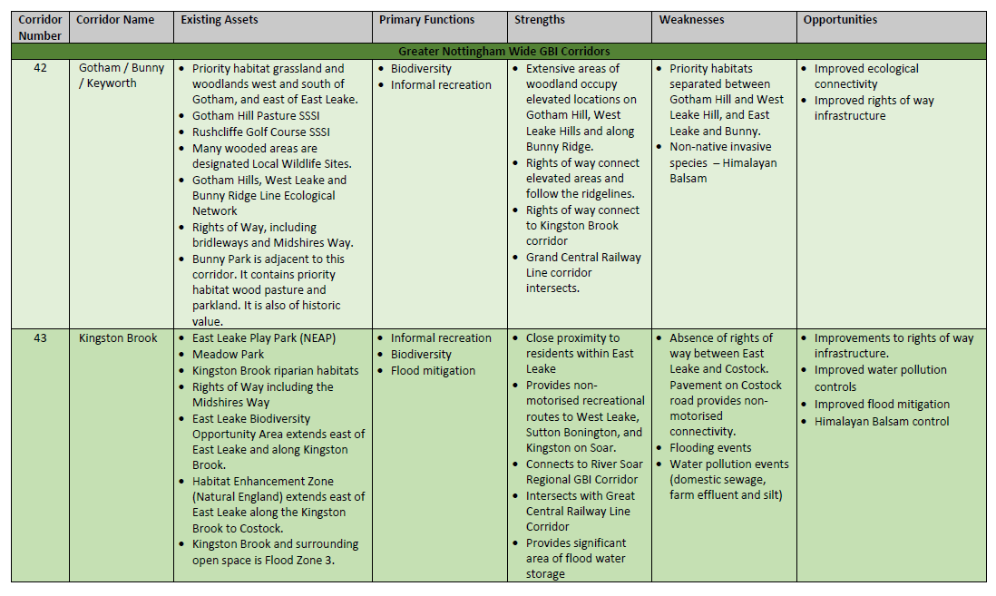
GBI Corridor Assessments

Slide 7
Ecological Networks
Informed by Biological Opportunity Maps
Absence of mapping work within Erewash and the City
Complement emerging Nature Recovery Networks
Prioritising biodiversity issues where new developments are within the network
Prioritising biodiversity within GBI corridors, where these overlap
Inform Biodiversity Net-Gain policies - identifying habitat types which also enhance connectivity.

Slide 9
Next Steps
Informal consultation with neighbouring authorities is currently taking place.
Consultation with key stakeholders on the Green and Blue Infrastructure Strategy will take place during early 2021
Consultation on the Green and Blue Infrastructure Strategy will take place Summer 2021 alongside the Draft Greater Nottingham Strategic Plan

