Slide 1
Joint Committee on Strategic Planning and Transport
JPAB GROWTH WORKSHOP FEEDBACK
6 September 2019

Slide 2
Background and Context
NPPF – development plan must include strategic policies
NPPF - spatial development strategies should be reviewed to assess whether they need updating at least once every five years
JPAB decision to review strategic planning policies (the Aligned Core Strategies)
‘Growth Workshop’ held on 26 March

Slide 3
Purpose of Workshop
Inform JPAB of current and evolving Government approach
Explore key issues affecting growth scale and location
Think about what “good growth” looks like

Slide 4
Current Approaches to Strategic Planning
Government seeking more effective strategic plans.
Better integration of spatial, infrastructure and economic priorities.
More joint planning arrangements, often driven by ‘deals’.
Models include voluntary and formal joint arrangements.
Our approach was innovative at the time, and remains appropriate for our area.

Slide 5
Workshop Discussion
1. Key strategic planning influences
2. Strategic Planning interventions needed to achieve “good growth”

Slide 6
Points from discussions
Importance of developing a shared ‘narrative’ about our collective ambitions for the area.
Understand and articulate better the impact and benefits of HS2.
Define what our ‘USP’ is:-
Good quality of life.
Enhance the liveability of GN as a place.
Potential of corridors and nodes
Importance of Green Infrastructure

Slide 7
Green Infrastructure
Mentioned throughout
Excellent existing network
Excellent track record (Wetlands for All etc)
Feeds into:-
Health and wellbeing
Liveability
Quality of life
Sustainable economic structure
Resilience (eg flooding and climate change)
Making growth acceptable (‘good growth’)

Slide 8
Towards a growth strategy
Green Infrastructure and growth planned and implemented together – integrated strategy
NOT an after thought/add on
Building on existing strengths
Green Infrastructure at the heart of our growth strategy will help delivery of other priorities eg HS2

Slide 9
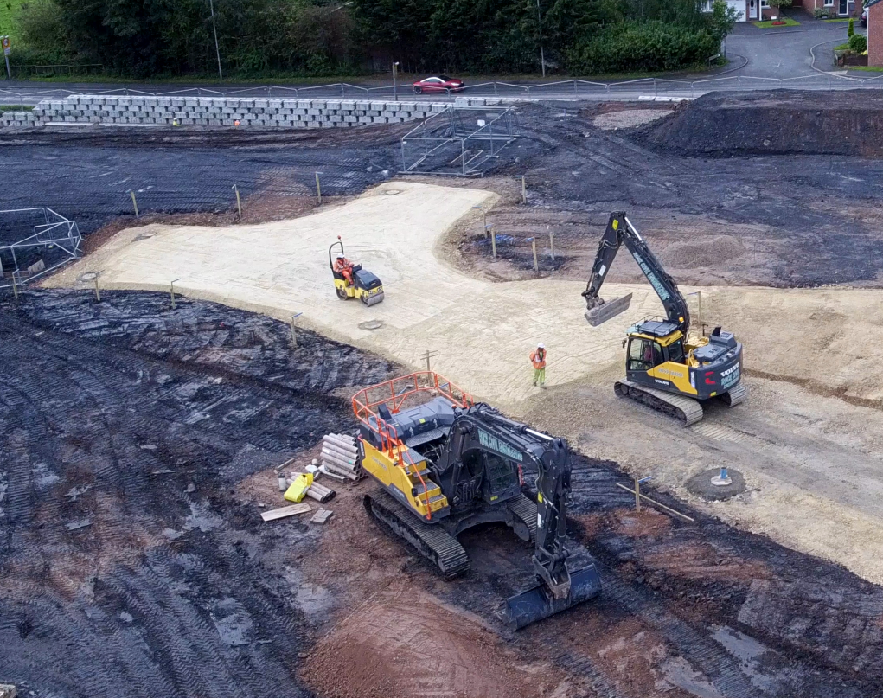
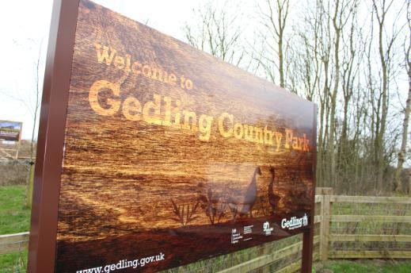

Slide 10
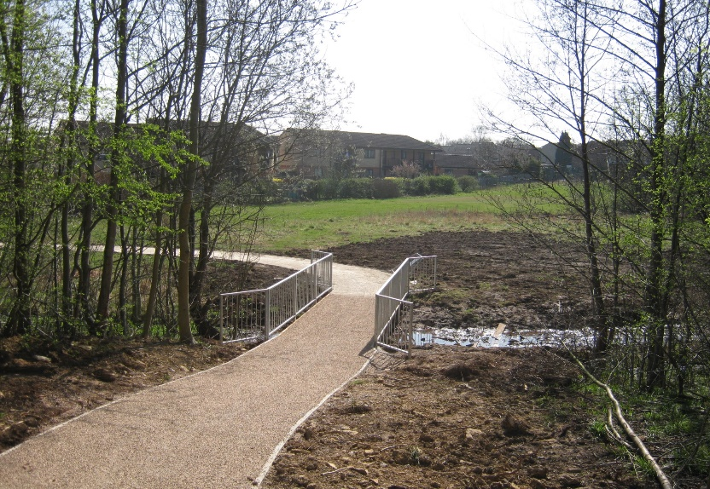
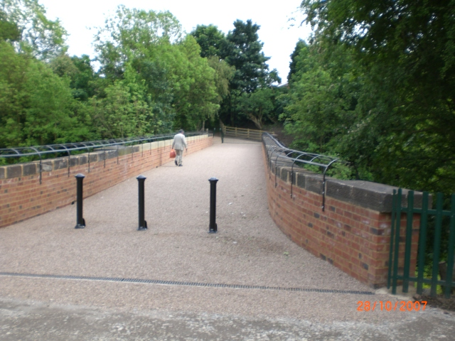
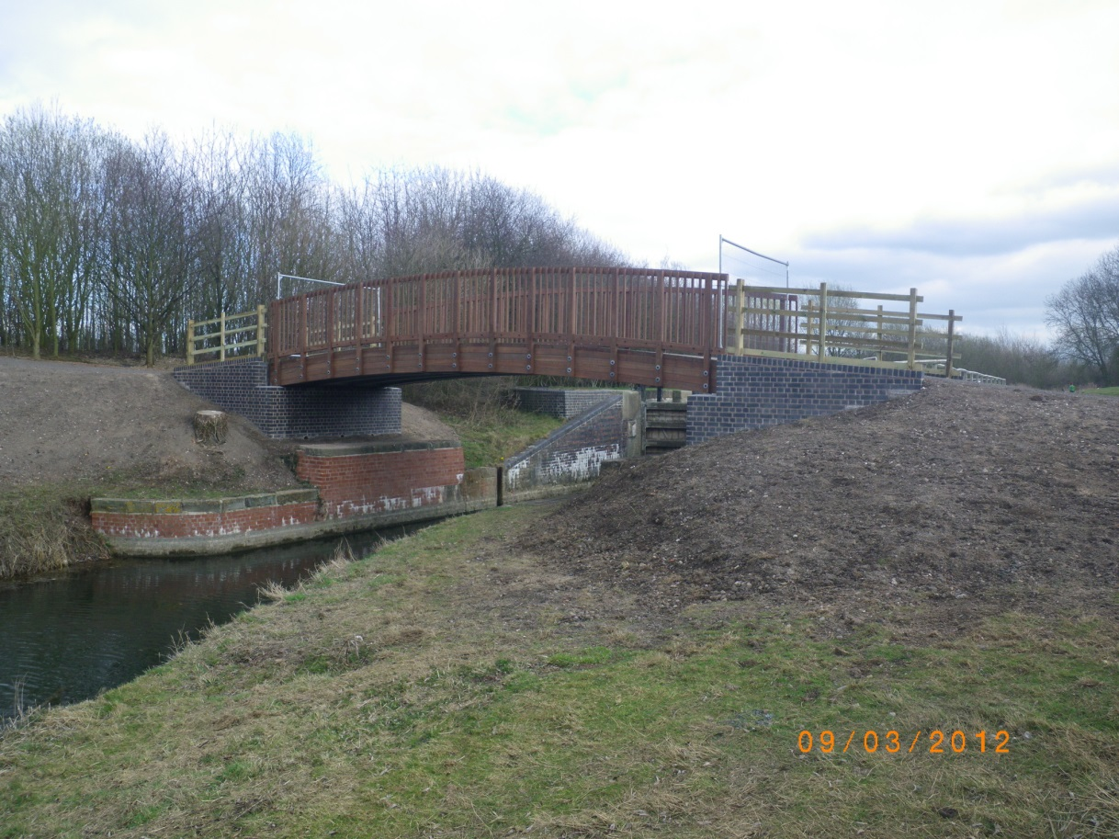

Slide 11
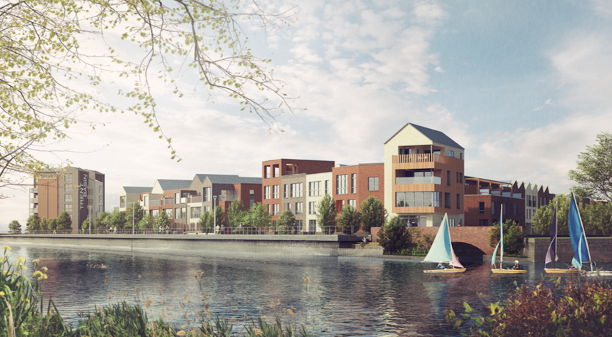
Questions and comments?

