Slide 1
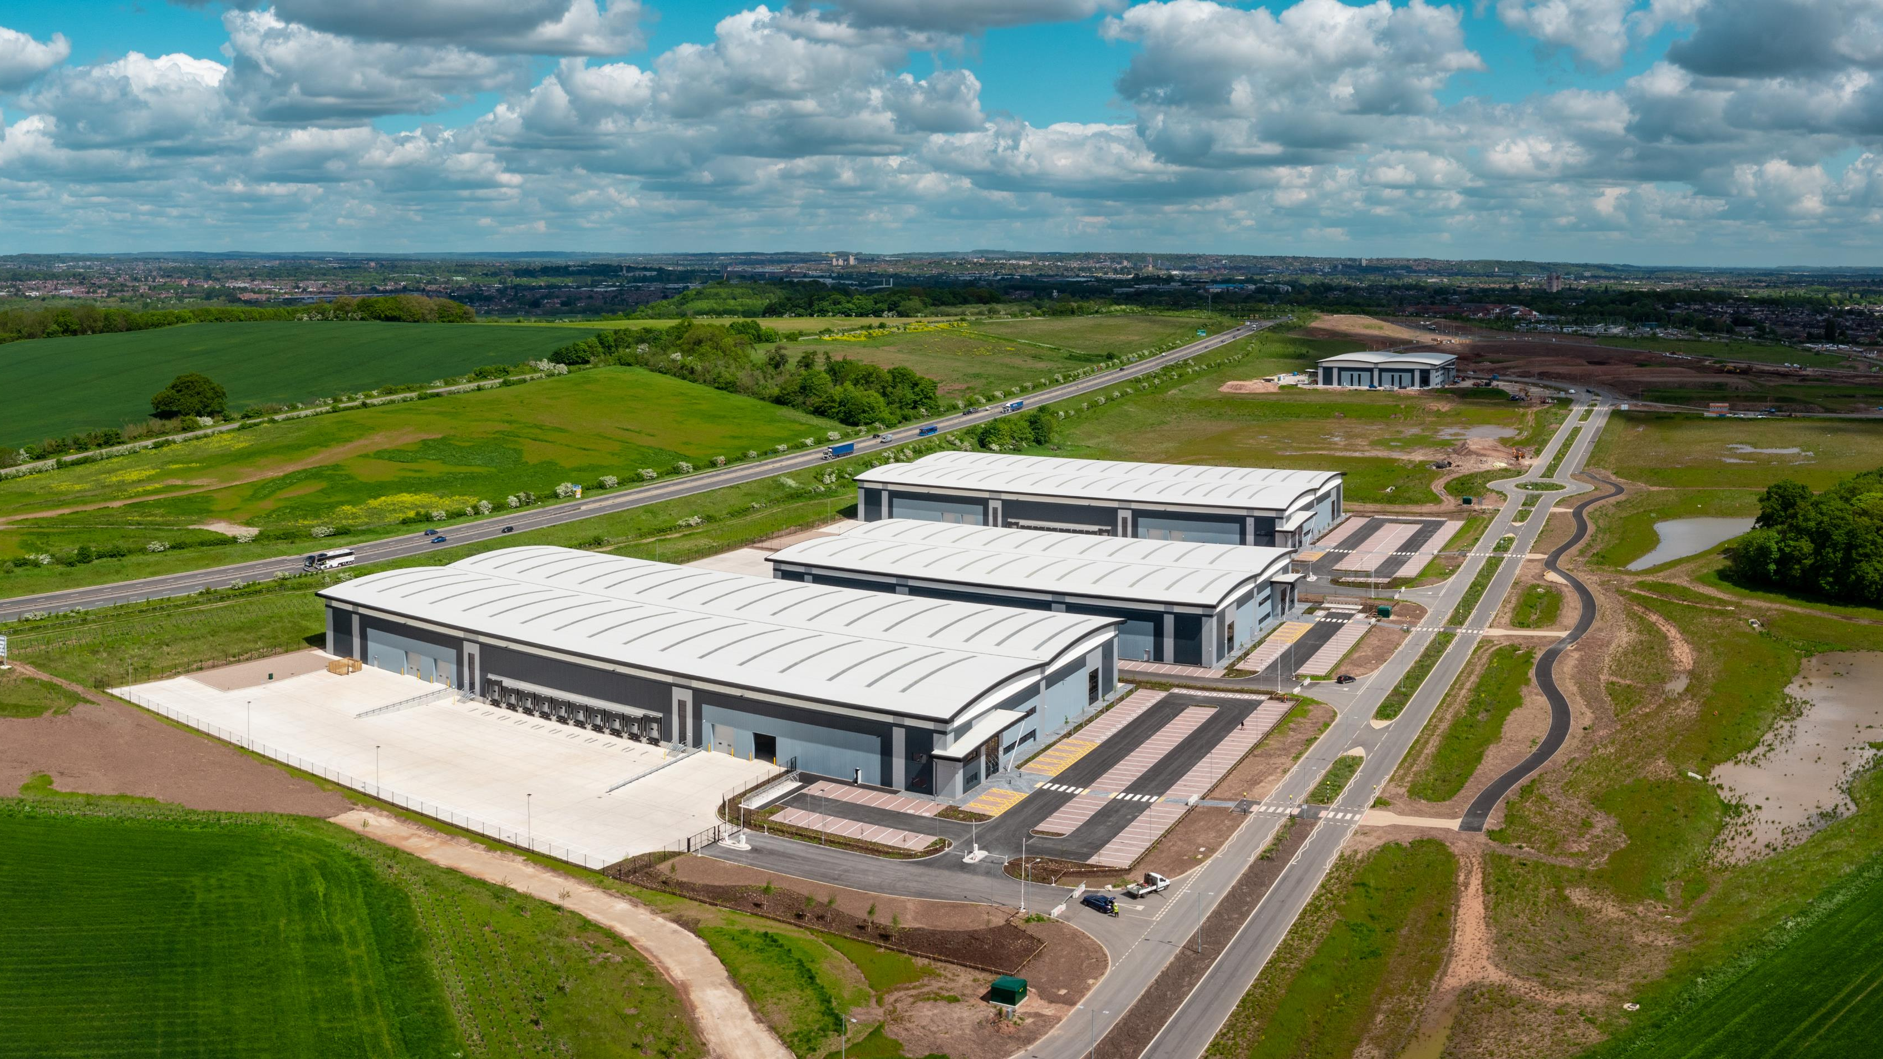
Distribution and Logistics Preferred Approach – Consultation Reponses
John King
Conurbation Planning Policy Manager

Slide 2
Consultation Response
Received responses from 53 consultees
134 individual representations
Comments received from:
Statutory consultees (LPAs, P/TCs, Govt environmental bodies);
Local groups;
Residents; and
Landowners.
Comments submitted on the: calculation of the plan’s target; preferred sites; and alternative or additional sites.

Slide 3
Comments on Need, Supply and Target
Support GNPP focus on strategic logistics
Need to align housing and employment targets
GNSP must meet identified need (across the Core and Outer HMA)
GNSP should identify target figures for each authority
Target should be greater, reflecting:
growing demand;
lower developable areas;
Uncertain delivery of commitments;
Lower redevelopment contributions; and
Need for a 10% buffer.
Green Belt should not be a constraint
Consistency between sites in supply and site selection process

Slide 4
Former Bennerley Disposal Point
Loss of Green Belt
Adverse effects on:
Bennerley viaduct
Blue and Green Infrastructure
Biodiversity
Landscape and visual amenity
Flood zones
Limited developable area
Accessibility – by non-car modes
Site access onto A610

Slide 5
Ratcliffe on Soar Power Station
Implications of HS2 cancellation
Must deliver advanced manufacturing – focus on low carbon and renewable technologies
Loss of Green Belt and green field land – south of the A453
Environmental impacts – south of A453
Accessibility – by non-car modes

Slide 6
Next Steps
Prepare for Regulation 19 consultation
Summarising, reviewing and responding to comments
Further discussions with key stakeholders
Update background paper, Sustainability Appraisal and strategic logistics policies

