Slide 1
Greater Nottingham Centres Study
Presentation to Members

Slide 2
The specification
Identify whether the current overall hierarchy of retail centres is appropriate and fit for purpose in the context of current and future retail trends.
Provide an assessment of the Greater Nottingham Centres to cover two elements:
Detailed analysis of the City Centre, Town Centres and District Centres; and
General trend analysis for the Greater Nottingham Centres.
Review of the local impact assessment thresholds implemented in each of the authority areas to assess whether any amendments are required;
Consider the impact of the housing growth proposed on retail and associated uses;
Consider local stakeholder and business views on the strengths, weaknesses, opportunities and threats to the Greater Nottingham centres; and
Review the existing designated frontages, primary shopping areas and town centre boundaries of the defined centres within Greater Nottingham.

Slide 3
Policy background – national level
Paragraph 90 of the NPPF states that planning policies should:
define a network and hierarchy of town centres and promote their long-term vitality and viability – by allowing them to grow and diversify in a way that can respond to rapid changes in the retail and leisure industries, allows a suitable mix of uses (including housing) and reflects their distinctive characters;
define the extent of town centres and primary shopping areas, and make clear the range of uses permitted in such locations, as part of a positive strategy for the future of each centre;
retain and enhance existing markets and, where appropriate, re-introduce or create new ones;
allocate a range of suitable sites in town centres to meet the scale and type of development likely to be needed, looking at least ten years ahead. Meeting anticipated needs for retail, leisure, office and other main town centre uses over this period should not be compromised by limited site availability, so town centre boundaries should be kept under review where necessary;
where suitable and viable town centre sites are not available for main town centre uses, allocate appropriate edge of centre sites that are well connected to the town centre. If sufficient edge of centre sites cannot be identified, policies should explain how identified needs can be met in other accessible locations that are well connected to the town centre; and
recognise that residential development often plays an important role in ensuring the vitality of centres and encourage residential development on appropriate sites.

Slide 4
Policy implications for greater nottingham
Supporting flexibility in town centres – town centre accommodation needs to be adaptable to a number of uses to address future needs. This presents both opportunities and challenges for Greater Nottingham’s defined centres. The previous orthodoxy of protecting A1 retail uses within Primary Shopping Areas may unwittingly be restricting the ability of town centres to diversify and develop distinctive identities and associated offer to consumers. Whilst supporting flexibility is therefore key, there must still be an overarching concentration of retail uses within defined centres, given the draw and attraction of such uses and their assistance in helping to support the vitality and viability of centres overall.
Encouraging a mix of town centre uses – town centres are increasingly diverse with the emergence of a greater proportion of leisure, food and drink uses. There is also an identified need to concentrate multi-functional public services in town centre locations to realise agglomeration benefits. However, town centres face rapidly increasing competition from retail parks and higher order centres as well as online shopping. The integration of commercial and residential uses within town centres is important to their overall vibrancy, to encourage footfall within centres throughout the day and evening. This includes access to high quality public transport.
The hierarchy of centres – the role of each defined centre within Greater Nottingham needs to be clearly articulated to provide it with a distinct and recognisable identity appropriate to its role. It will be important to identify the unique attributes of each defined centre during the production of the Strategic Plan and new Local Plans.

Slide 5
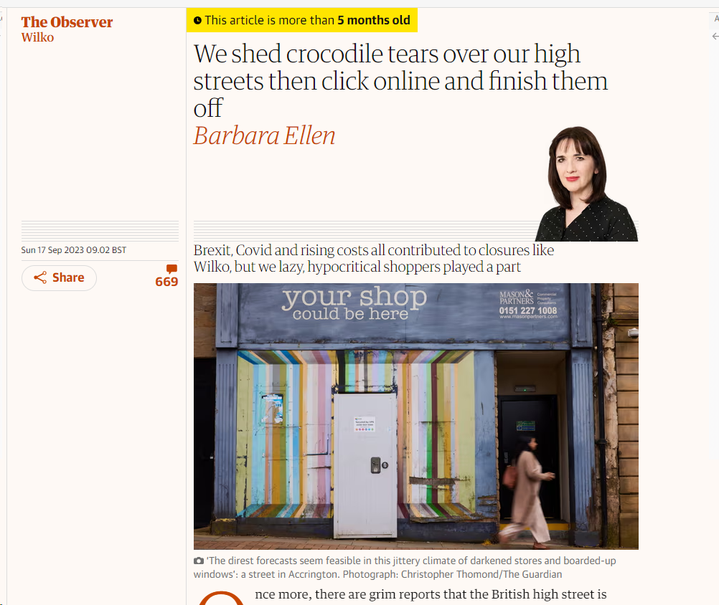
Overview of key trends
Retail sales forecast to reduce in the short term, with growth returning over the longer term.
Proportion of retail sales online has increased, and was accelerated by Covid.
Expected reduction in the stock of retail floorspace over the next few years.
However, there will still be a need for physical stores (25% of comparison sales and 75% of convenience sales online is still ‘picked’ from physical shelves), but the shopping experience needs to evolve.
Leisure uses form an important part of the wider role of the larger centres in particular, providing opportunities for both independent and national multiples.
Housing will also be a key use within centres, helping to generate footfall and associated expenditure.

Slide 6
healthchecks
Paragraph 006 of the Town Centres PPG identifies a range of indicators that should be assessed over time in order to establish the health of a town centre. The indicators include the following:
diversity of uses;
proportion of vacant street level property;
retailer representation and intentions to change representation;
pedestrian flows;
accessibility;
perception of safety and occurrence of crime;
the state of town centre environmental quality;
the balance between independent and national multiple retailers; and
the extent to which there is an evening and night-time economy.

Slide 7
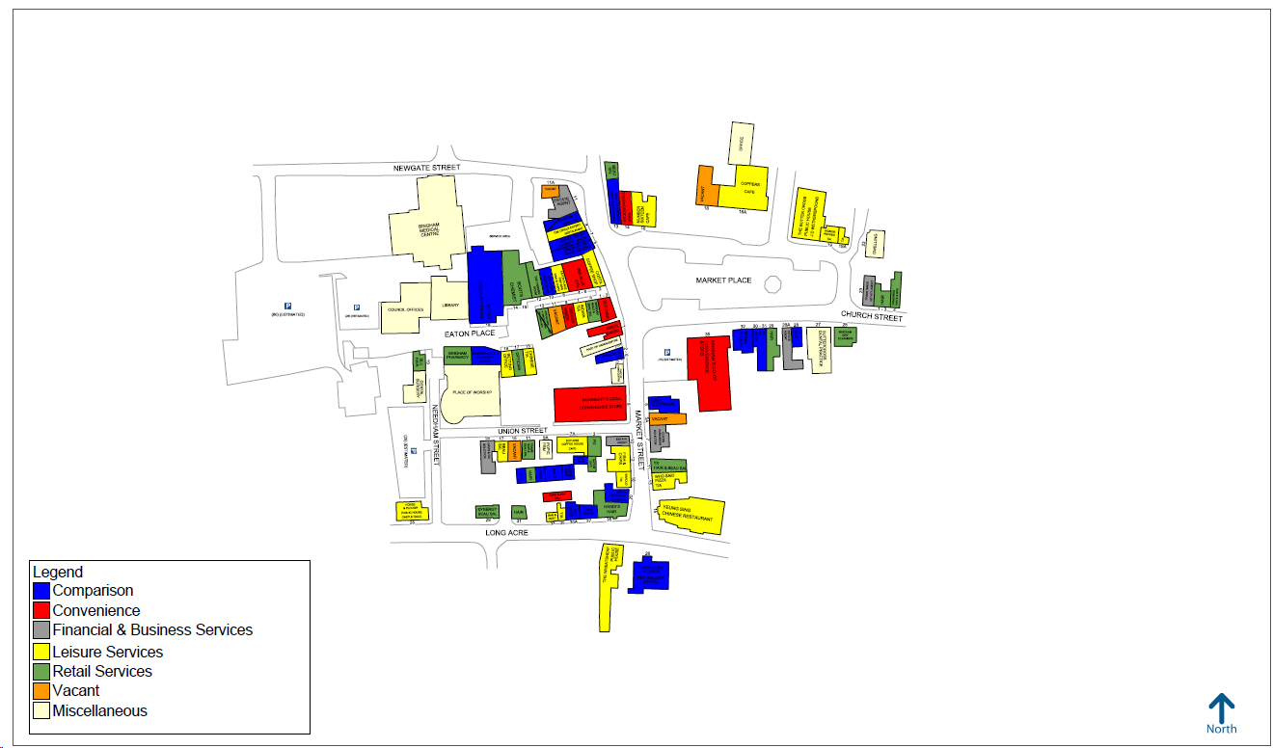
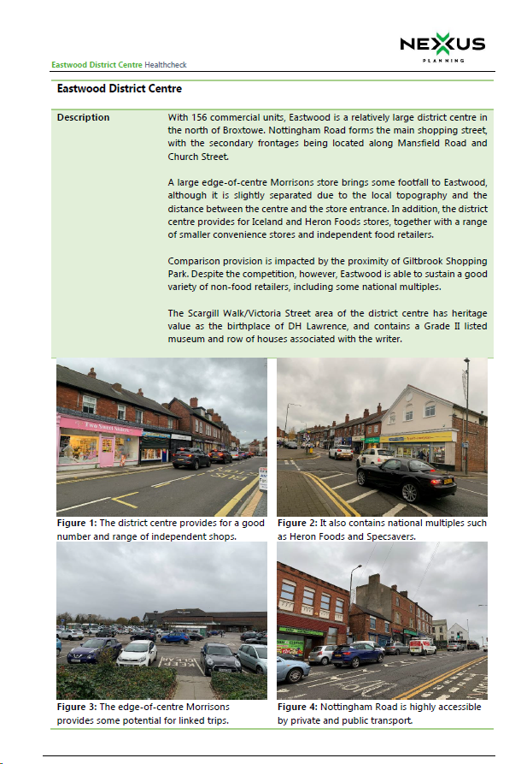
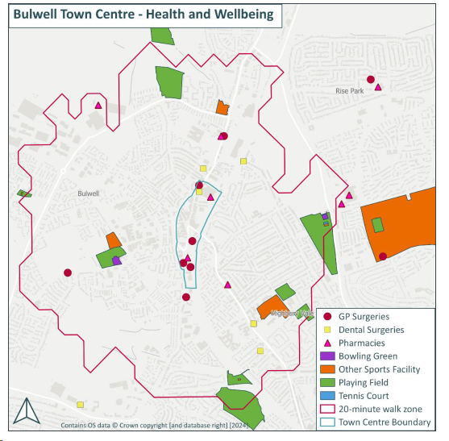
Healthchecks – overview

Slide 8
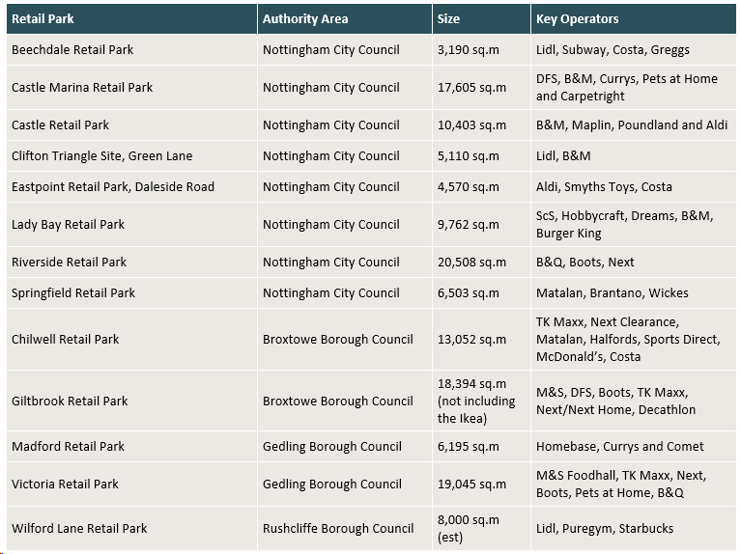
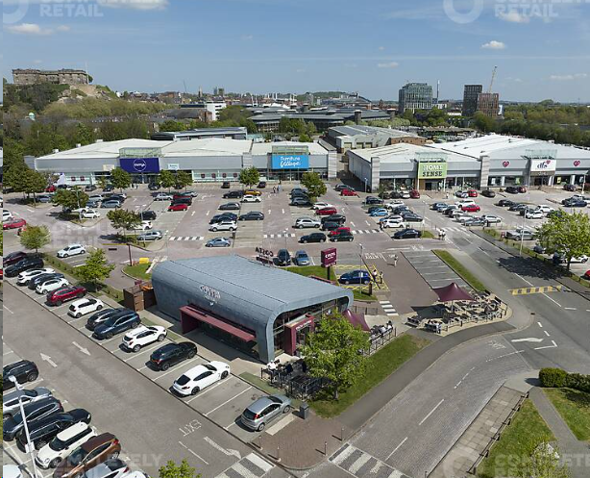
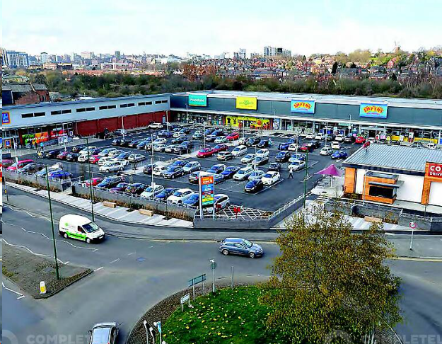
Out of centre provision

Slide 9
Key strategic recommendations
The objective is to ensure that, where possible, the growth of an inclusive economy, which provides access to jobs, opportunity, skills acquisition, products and services, culture, leisure, healthy lifestyles and social connection.
Important for the forthcoming strategic plan to clearly identify that the larger defined centres should continue to be the focus for comparison goods retail and that there is a need to direct such operators towards the centres to ensure they remain relevant and appropriately serve residents’ needs.
The sequential and impact tests will need to be applied in a robust manner to reduce the vacancy rate across the defined centres and support centres that are fit for purpose going forward.
Defining a proportion of frontages within primary shopping areas which should be retained within retail (formerly Class A1) uses will no longer be appropriate across the board.
The reuse of existing stock, the repurposing of important town centre assets to provide active uses such as leisure, community and residential uses, and wider aesthetic improvements to encourage safe pedestrian movement and promote pleasant town centre environments.

Slide 10
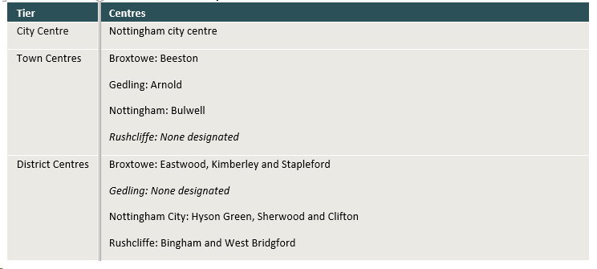
Specific policy recommendations - hierarchy

Slide 11
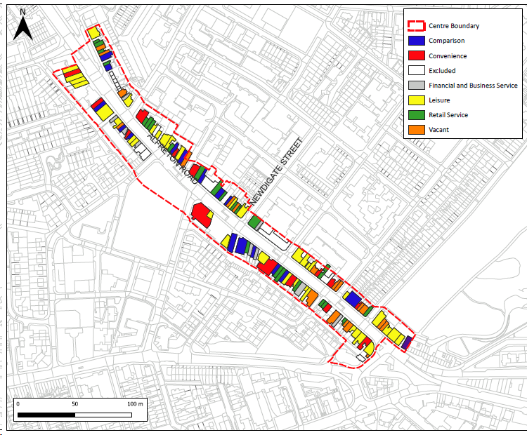
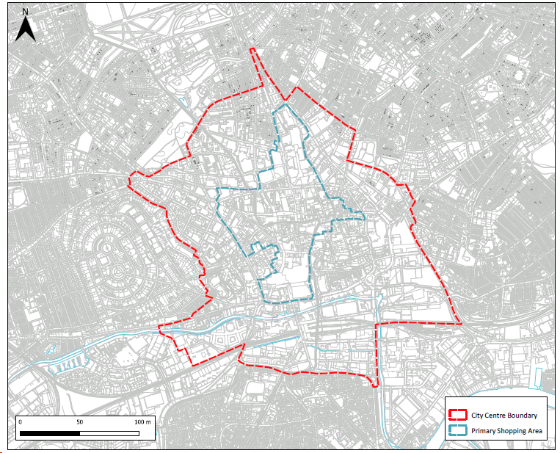
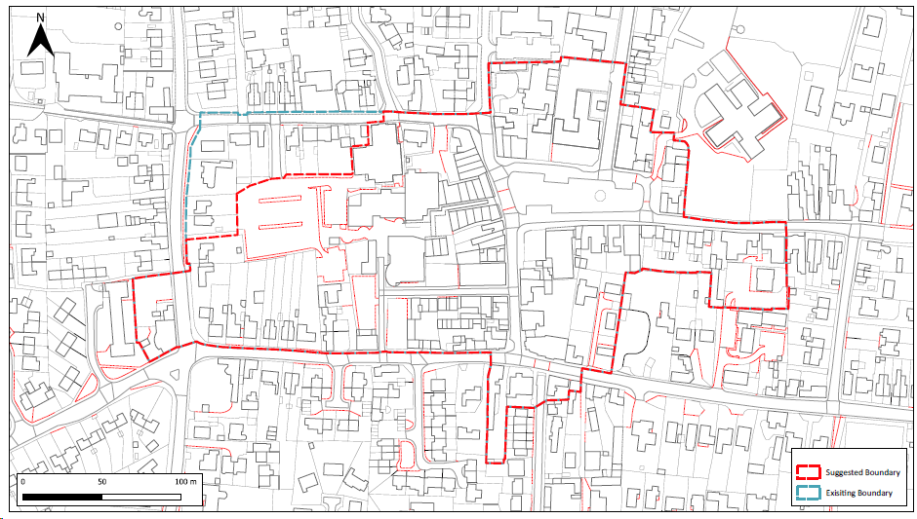
boundaries
NPPF Annex 2 Definitions
Primary Shopping Area – defined area where retail development is concentrated
Town Centre – area defined on the local authority’s policies map, including the primary shopping area and areas predominantly occupied by main town centre uses within or adjacent to the primary shopping area
NB. No reference to primary and secondary frontages in the NPPF

Slide 12
thresholds
We are of the view that an impact assessment will be necessary to accompany proposals for retail and leisure uses (including those relating to mezzanine floorspace and the variation of restrictive conditions) which are not located within a defined centre where:
the proposal provides a gross floorspace in excess of 500 sq.m gross; or
the proposal is located within 800 metres of either;
the city centre and is in excess of 500 sq.m gross; or
a town centre (including the principal town centre) and is in excess of 300 sq.m gross; or
a district centre and is in excess of 300 sq.m gross; or,
a local centre and is in excess of 200 sq.m gross.
To Note:
The impact assessment only applies to retail and leisure development.
‘In centre’ for the purposes of retail development comprises the Primary Shopping Area. For leisure uses, it comprises the wider town centre boundary (or City Centre Boundary).
It is not a means to stop proposals, but a means by which the Council can protect centres through appropriate assessments.

